Slide 1
LATIN FOR GARDENERS
WHY???
HOW???
WILL I EVER USE THIS???

Slide 2
FIFTY SHADES OF ALL COLORS
BLACK – niger, nigrescens, nigricans
WHITE – alba, lacteus, nivalis, virginalis
GRAY – griseus, lividus, cinereus
REDS – ruber, roseus, sanguineus
BLUES – azureus, lilacinus, purpureus
YELLOWS – aureus, cupreus, luteus
GREENS – glaucus, sempervirens, viridis

Slide 3
BLACK
Helleborus niger
Ophiopogon nigrescens
Iris nigricans
niger
nigrescens
nigricans

Slide 4
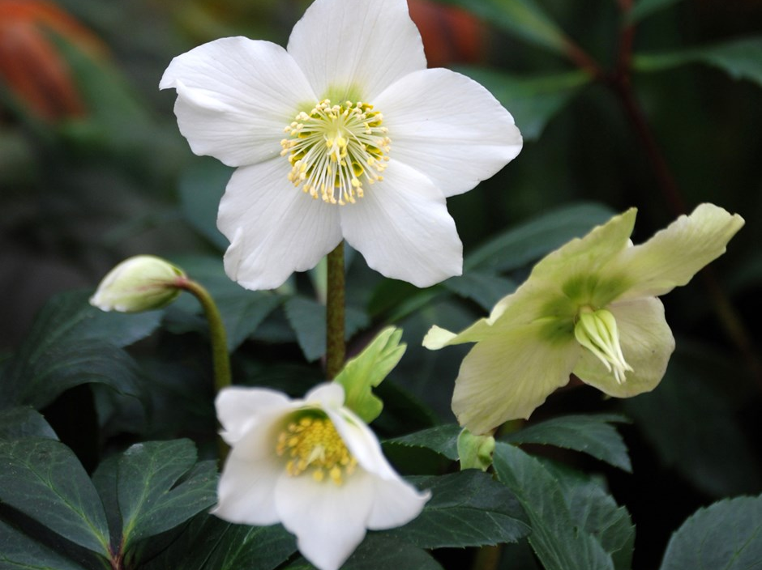
niger – black, dark
Helleborus niger
Common name – Christmas Rose

Slide 5
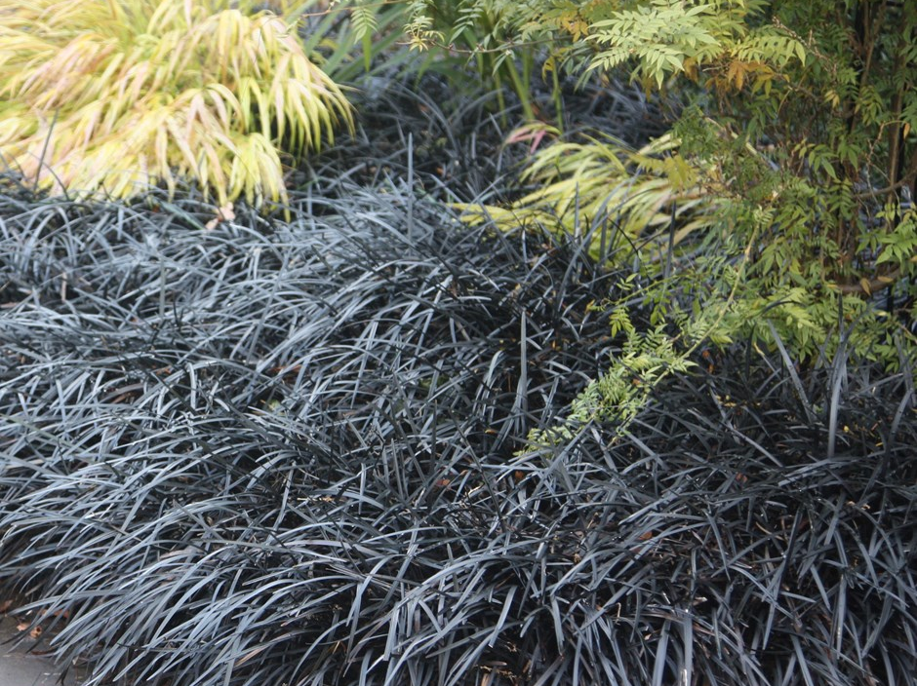
nigrescens – blackening, darkening
Ophiopogon nigrescens
Common name – Black Mondo Grass

Slide 6
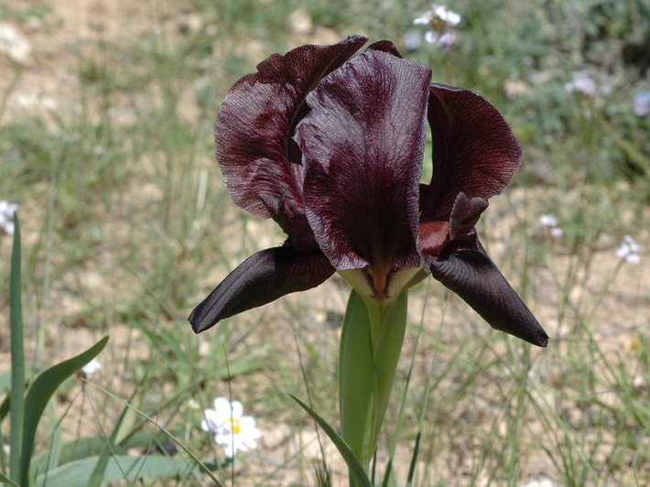
nigricans - blackish
Iris nigricans

Slide 7
WHITE
Betula alba
Cotoneaster lacteus
Galanthus nivalis
Philadelphus virginalis
alba
albicans
lacteus
nivalis
virginalis

Slide 8
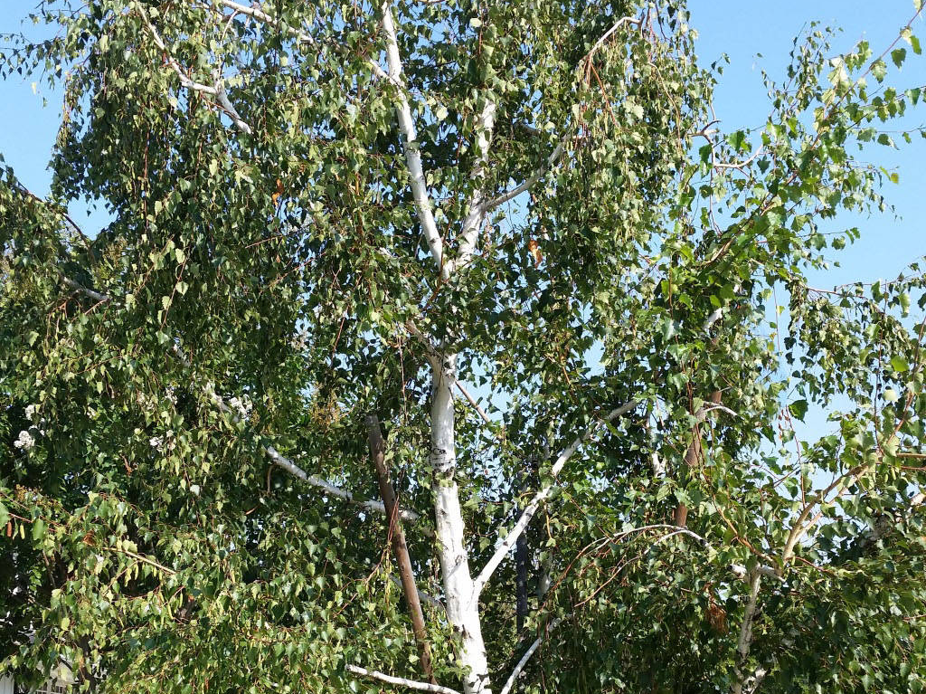
alba – white
Betula alba
Common Name – White Birch

Slide 9
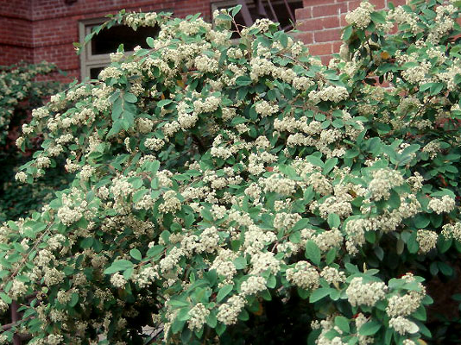
lacteus – of or pertaining to milk, milky
Cotoneaster lacteus
Common Name – Red Clusterberry, Parney Cotoneaster, Milkflower Cotoneaster

Slide 10
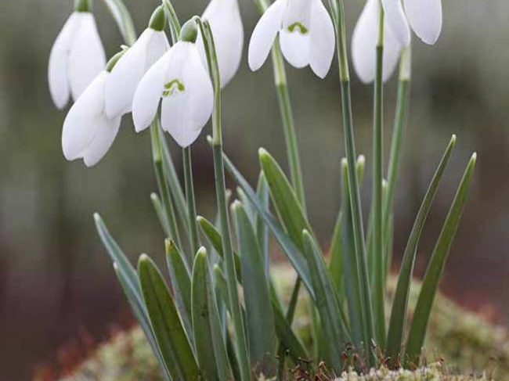
nivalis – snowy, snow-covered
Galanthus nivalis – for its snowy flowers
Common name – Snowdrop

Slide 11
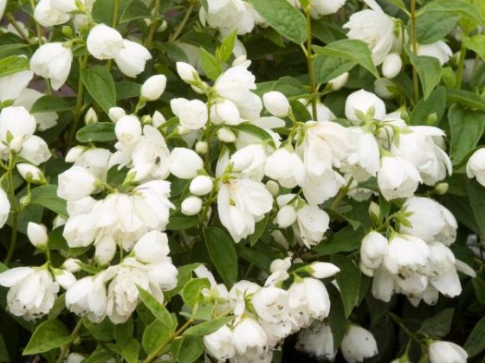
virginalis – maidenly; of or pertaining to a maiden or virgin
Philadelphus virginalis
Common Name – Mock Orange, Virginal Mock Orange

Slide 12
GRAY
Ceanothus griseus
Echinocactus cinereus
Helleborus lividus
griseus
cinereus
lividus

Slide 13
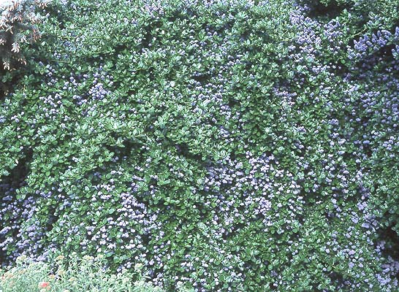
griseus - grey
Ceanothus griseus
Common Name – Yankee Point, Carmel Creeper, Carmel Ceanothus

Slide 14
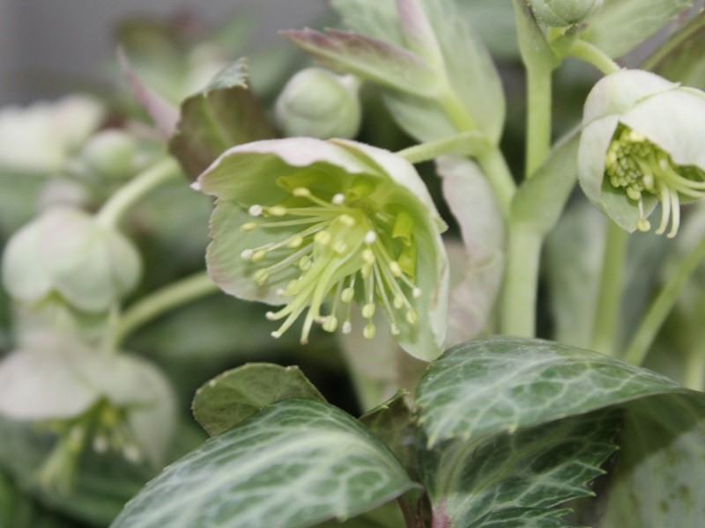
lividus – lead color, gray
Helleborus lividus
Common Name – Majorcan Hellebore

Slide 15
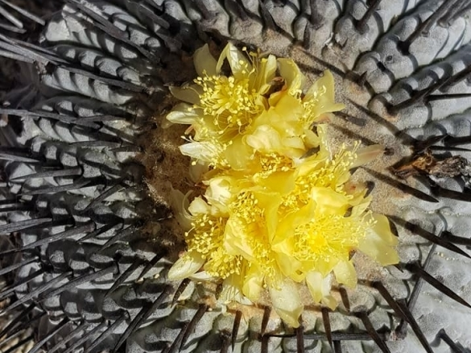
cinereus – ashen, like ashes
Echinocactus cinereus

Slide 16
REDS
Catharanthus roseus
Centranthus ruber
Ceanothus sanguineus
roseus
ruber
sanguineus

Slide 17
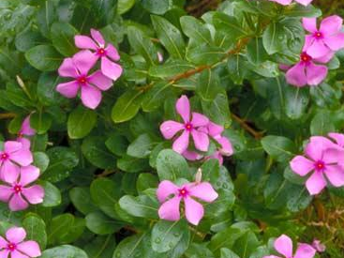
roseus – ink, rose-colored, rosy
Catharanthus roseus
Common Name – Old Maid, Madagascar Periwinkle

Slide 18
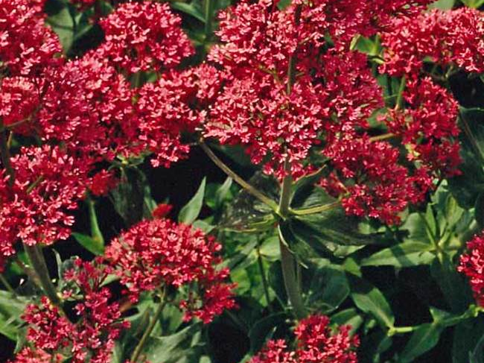
Ruber – red, ruddy
Centranthus ruber
Common Name – Red Valerian, spur valerian, kiss-me-quick, fox's brush, Devil's Beard and Jupiter's beard

Slide 19
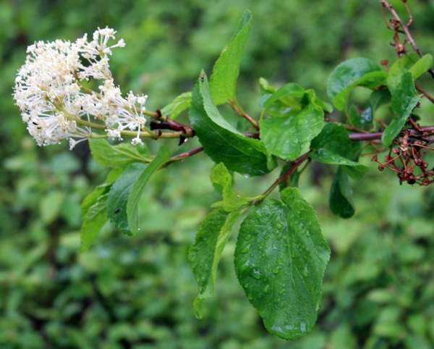
sanguineus – of blood, bloody, blood-coloured
Ceanothus sanguineus
Common Name – Red Stem Ceanothus

Slide 20
BLUES
Penstemon azureus
Trollius lilacinus
Cistus purpureus
azureus
lilacinus
purpureus

Slide 21
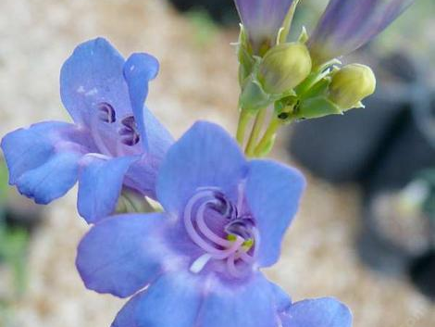
azureus – of a deep blue color
Penstemon azureus

Slide 22
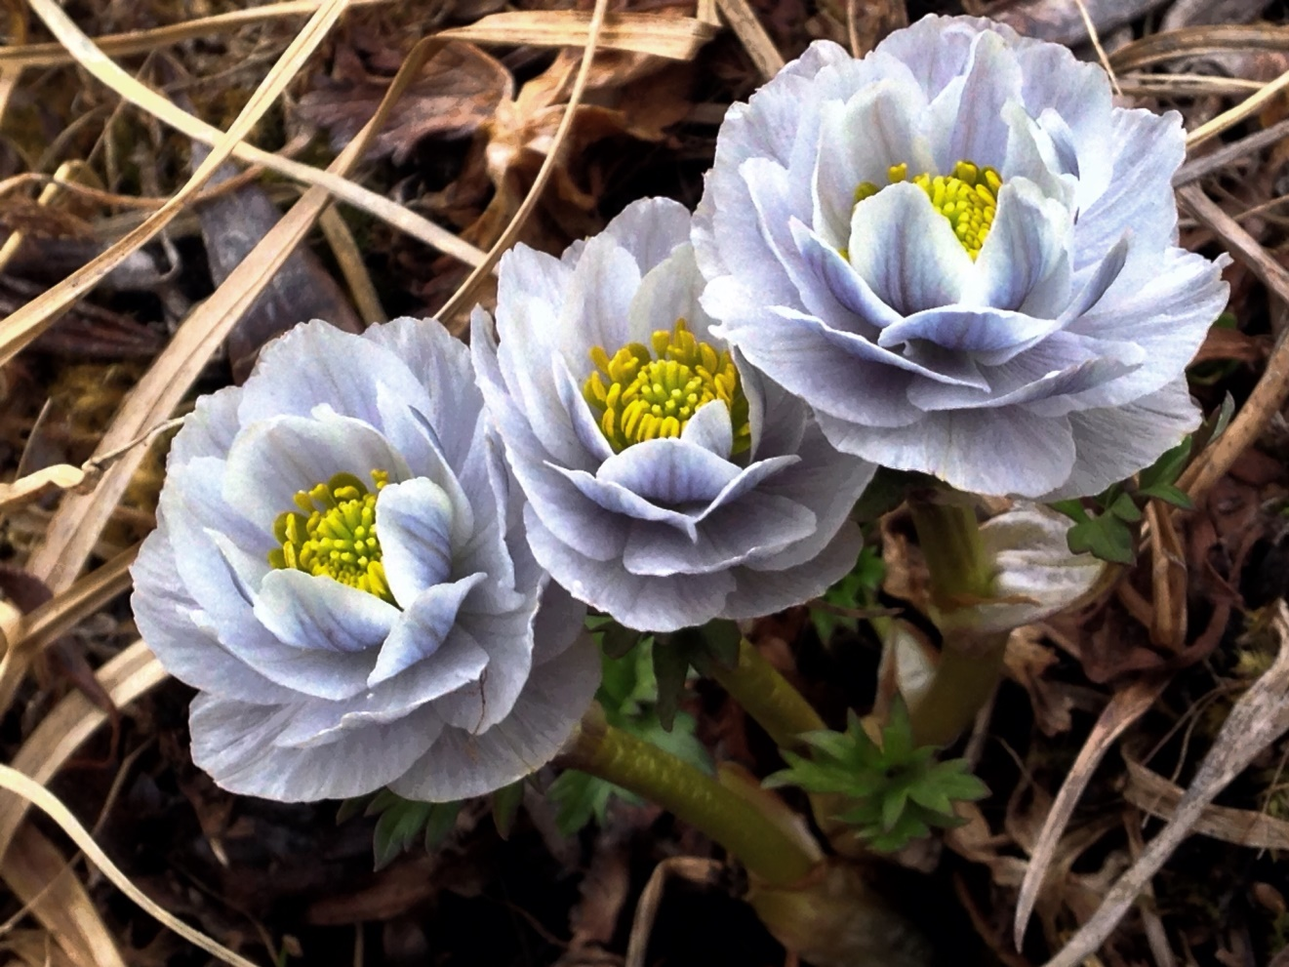
lilacinus – lilac-coloured
Trollius lilacinus

Slide 23
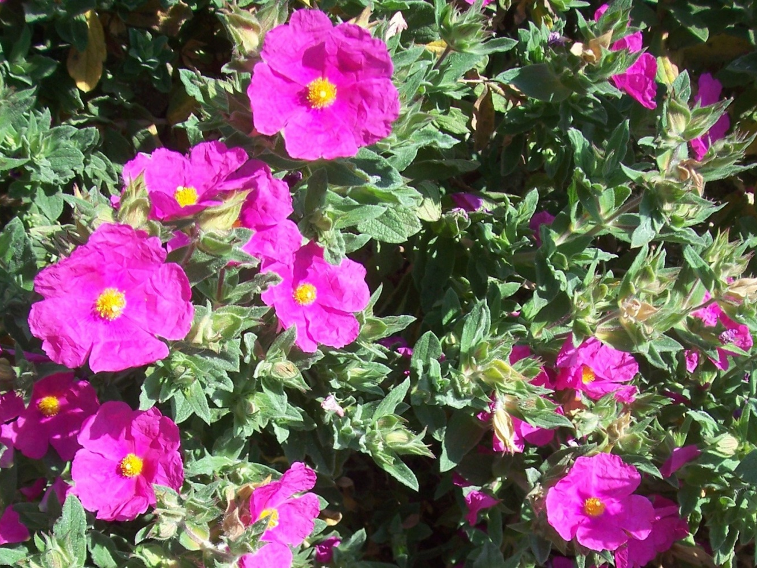
Purpureus – purple, clothed in purple
Cistus purpureus
Common Name – Rock Rose

Slide 24
YELLOWS
Erigeron aureus
Lupinus luteolus
Cosmos sulphureus
aureus
luteolus
sulphureus

Slide 25
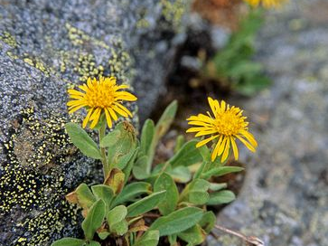
aureus - golden
Erigeron aureus
Common Name - Fleabane

Slide 26
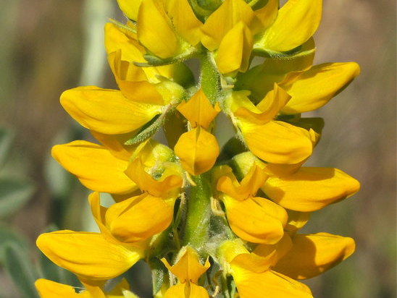
luteolus – yellowish
Lupinus luteolus
Common Name - Lupin

Slide 27
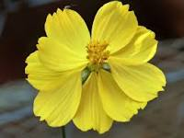
sulphureus – sulphur, pale yellow
Cosmos sulphureus

Slide 28
GREENS
Rosa glauca
Cupressus sempervirens
Crataegus viridis
glaucus
sempervirens
viridis

Slide 29
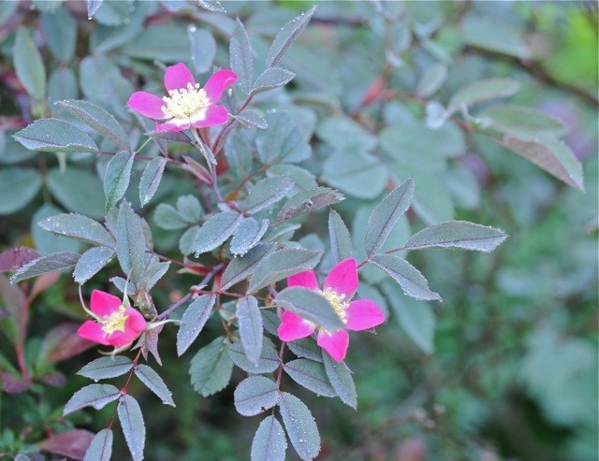
glauca – glaucous green, sea green
Rosa glauca

Slide 30
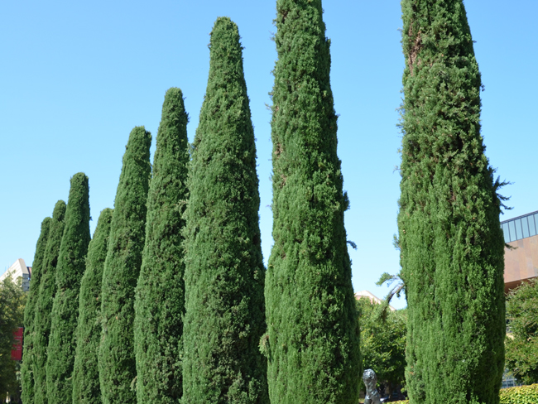
sempervirens – always green
Cupressus sempervirens
Common Name – Mediterranean Cypress

Slide 31
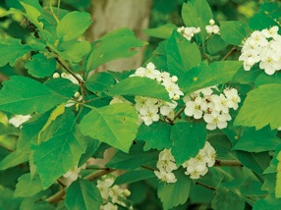
viridis - greenish
Crataegus viridis
Common Name - Green Hawthorn

Slide 32
NEXT TIME????
Markings - words like marginata
Flower Shape – words like stellatus
Leaf Shape – words like pungens
Plant Shape – words like frutescens

Slide 33
LATIN FOR GARDENERS
MARKINGS
FLOWER SHAPES
LEAF SHAPES
PLANT SHAPES

Slide 34
MARKING TERMS
Can mean markings on various parts of the plant – not just the leaves
marginata – edged, margined
pictum – painted
reticulata – netted, veined
variegatus - variegated

Slide 35
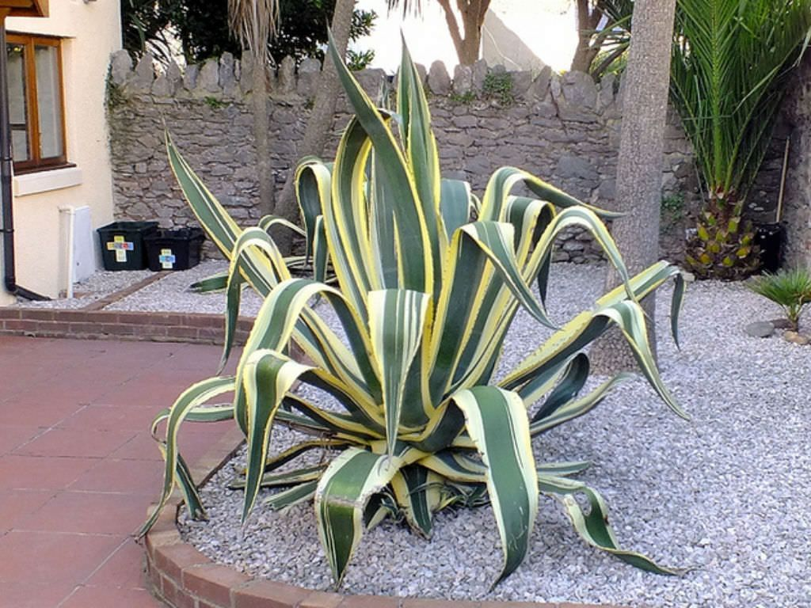
Agave americana ‘Marginata’ Common Name: Sentry Plant, Century Plant, Marguay and American Aloe
marginata – edged or margined

Slide 36
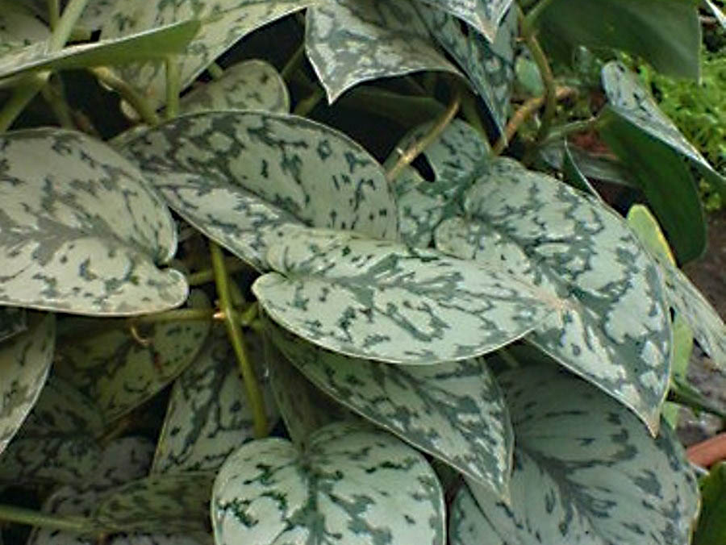
Scindapsus pictum Common Name – Silver Vine or Satin Pothos
pictum - painted

Slide 37
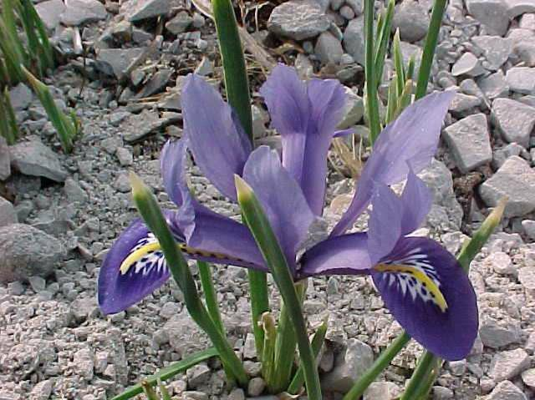
Iris reticulata Common Names: Netted Iris, Golden Netted Iris
reticulata – netted, veined

Slide 38
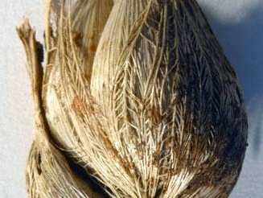
Iris reticulata bulb
The plant has the specific epithet reticulata because of the appearance of netting around the bulb

Slide 39
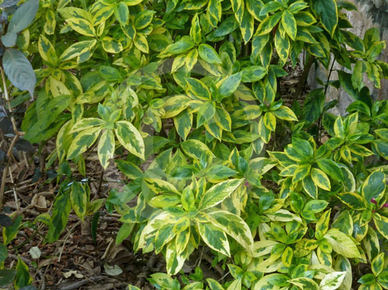
Graptophyllum pictum ‘Aurea-Marginata’ Common Name – Caricature Plant
pictum – painted
aurea – yellow or gold
marginata – margined or edged

Slide 40
Flower Shapes
SO MANY TO CHOOSE FROM!!
campanulatus – bell-shaped
flore-pleno – double-flowered
plumosus - feathery
ringens – two-lipped
stellatus – star-shaped

Slide 41
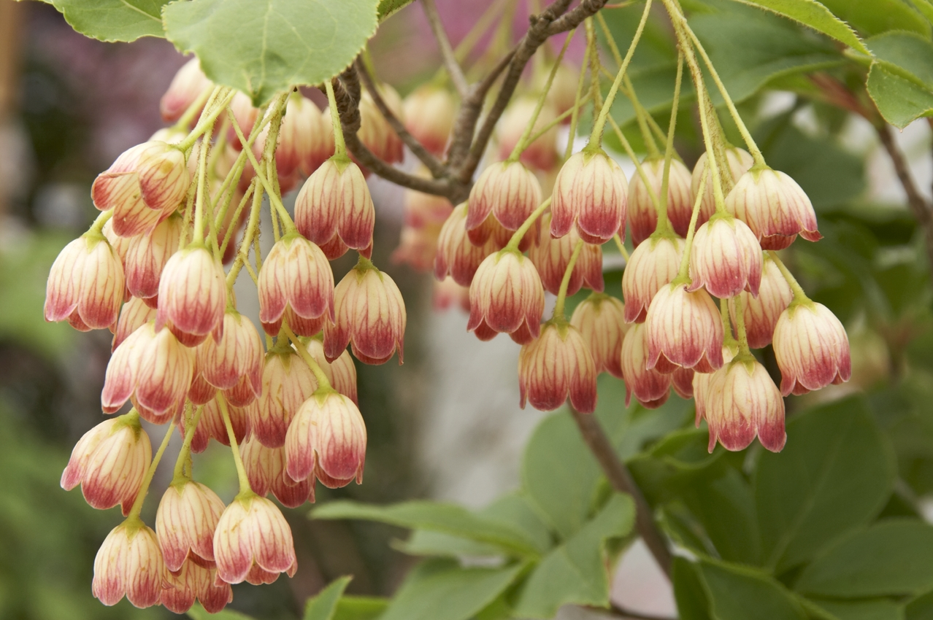
Enkianthus campanulata Common Name – Red-Vein Enkianthus
campanulata – bell-shaped

Slide 42
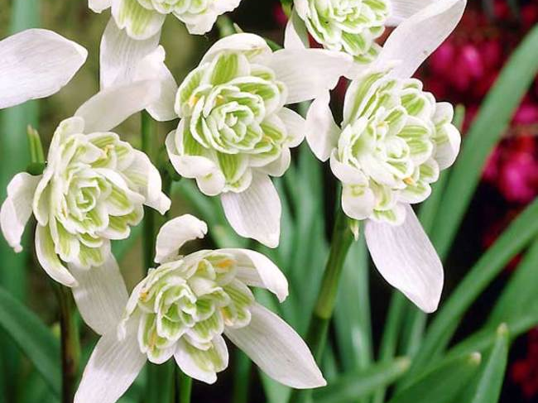
Galanthus nivalis flore-pleno Common Name – Double Snowdrop
nivalis – snow-white
flore-pleno – double flowered

Slide 43
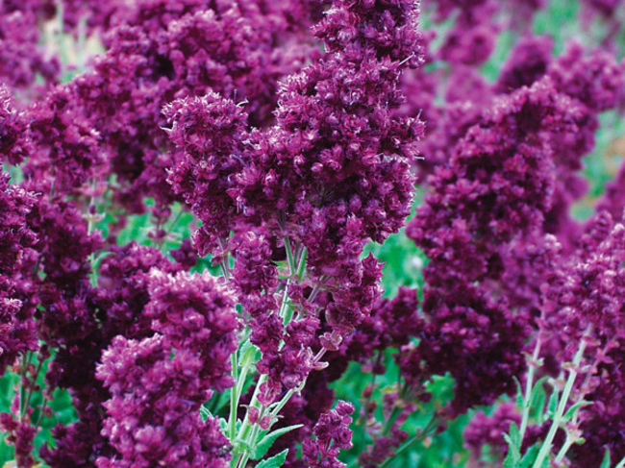
Salvia plumosa Common Name – Double Salvia
plumosa - feathery

Slide 44
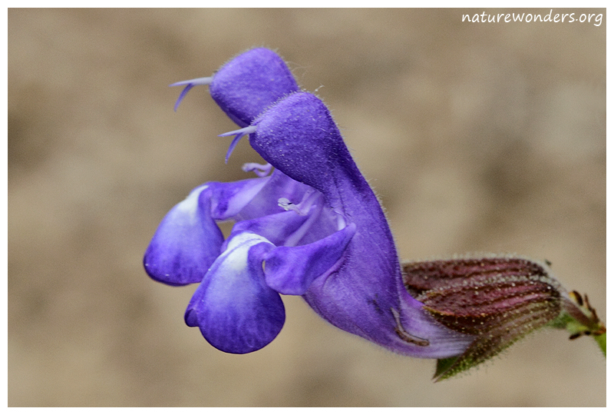
Salvia ringens Common name – Mount Olympus Sage
ringens – two-lipped

Slide 45
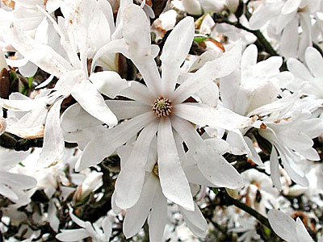
Magnolia stellata Common Name – Star Magnolia
Stellata – star-shaped

Slide 46
Leaf Shapes
dentatus – toothed
digitalis – fingered, like digits
flabellatus – Fan-shaped
incisus – deeply cut
pungens - pointed

Slide 47
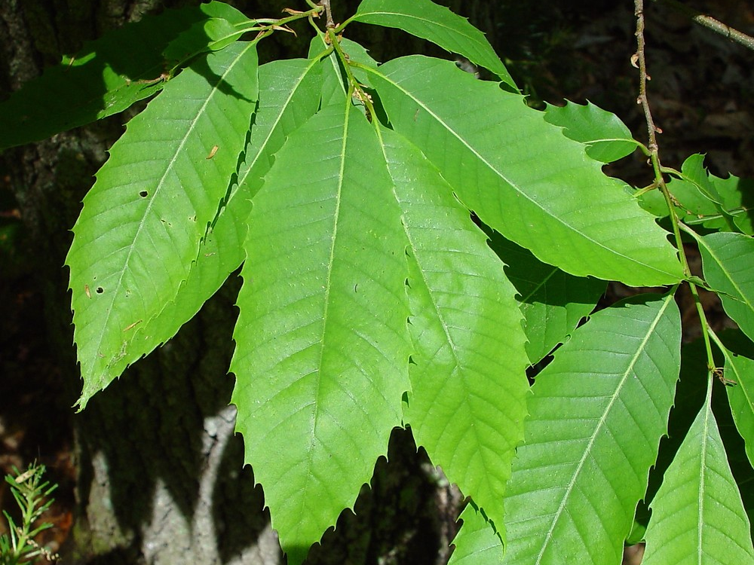
Castanea dentata Common Name - American Chestnut
dentata - toothed

Slide 48
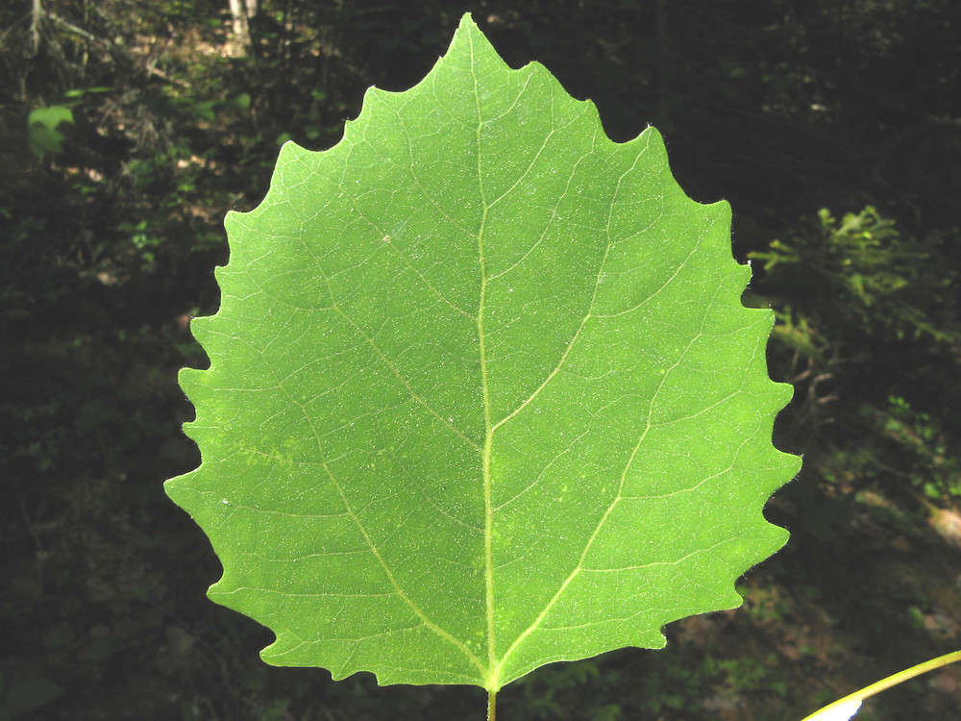
Populus grandidentata Common Names – Large-tooth Aspen, Big-tooth Aspen, American Aspen, White Poplar
grandidentata – BIG toothed

Slide 49
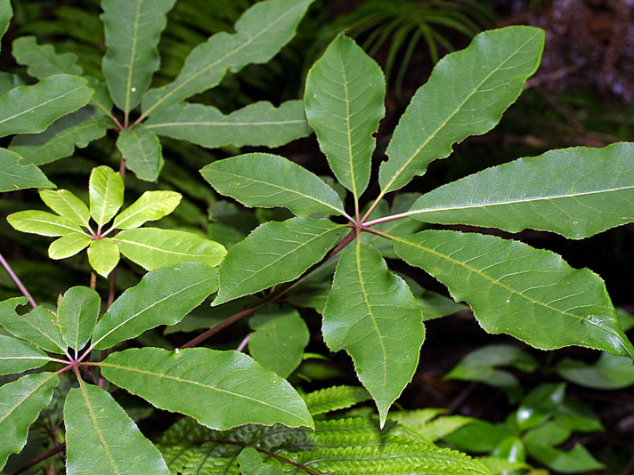
Schefflera digitalis Common Names – Pate, Seven-finger, Umbrella Tree
digitalis - fingered

Slide 50
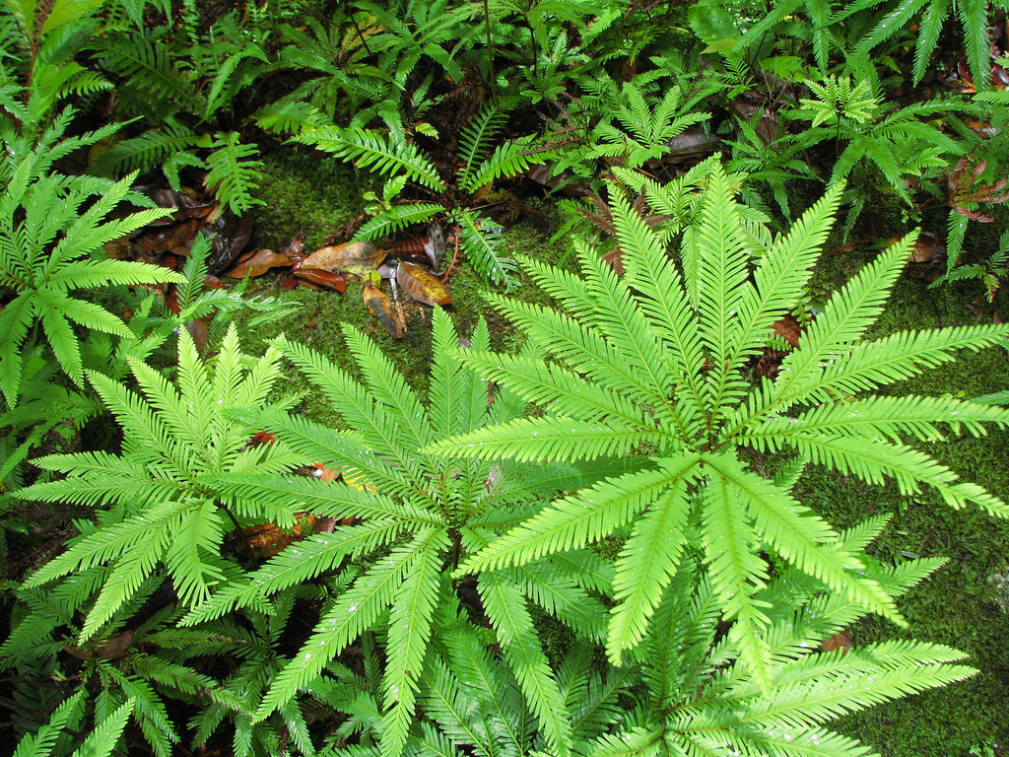
Sticherus flabellatus Common Name – Umbrella Fern
flabellatus – fan-shaped

Slide 51
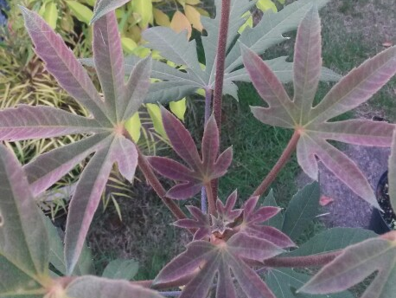
Oreopanex incisus Common Name: El Candelabro (Candelabrum)
incisus – deeply cut

Slide 52
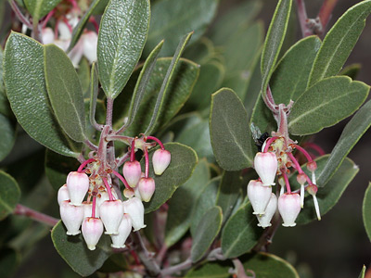
Arctostaphylos pungens Common Name – Pointleaf Manzanita
pungens - pointed

Slide 53
Plant Shapes
alatus - winged
deflexus – turned sharply downward or bending outward
fastigiatus – with upright branches
reptans - creeping

Slide 54
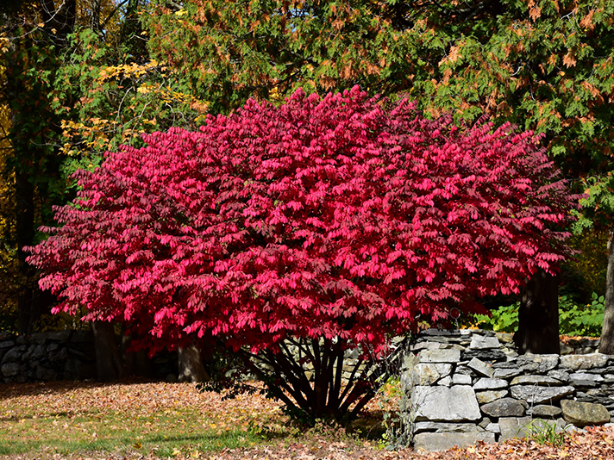
Euonymus alatus Common Name – Winged Burning Bush
alatus - winged

Slide 55
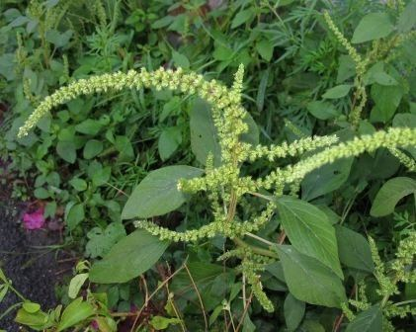
Amaranthus deflexus Common Names: Large-fruit Amaranth, Low Amaranth, Argentina Amaranth, Perennial Pigweed
Deflexus – turned sharply downward or bending outward

Slide 56
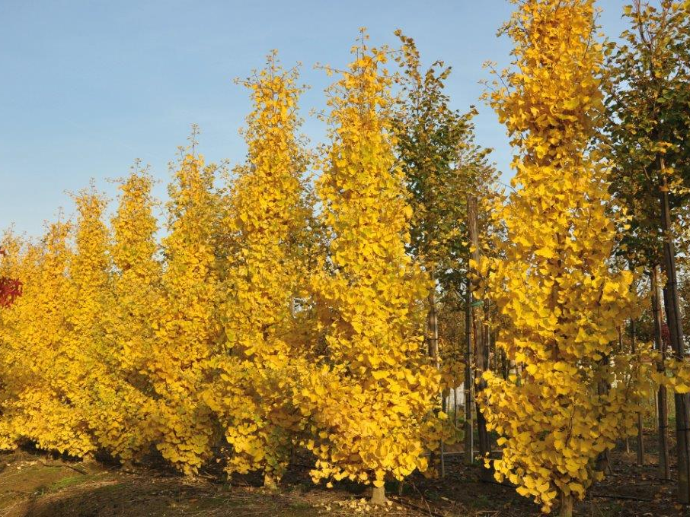
Ginkgo biloba fastigiata Common Name – Maidenhair Tree
fastigiata – with upright branches

Slide 57
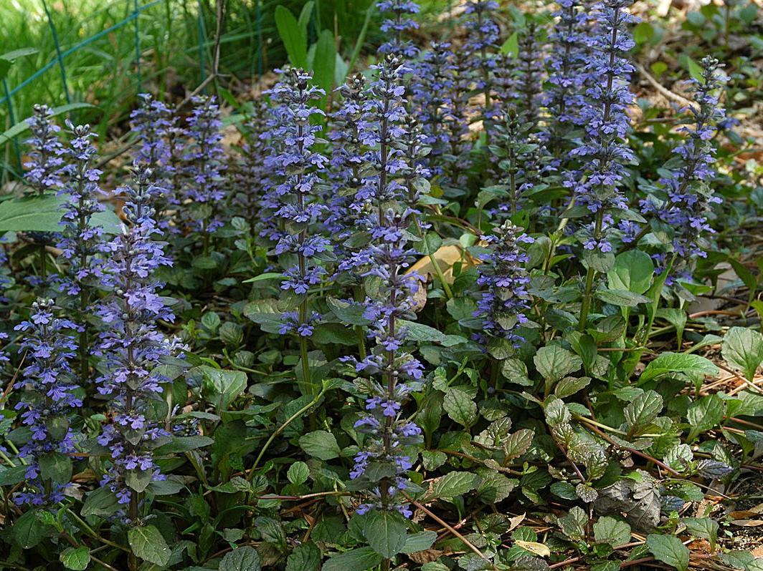
Ajuga reptans Common Names: Bugle, Blue Bugle, Bugleherb, Bugleweed, Carpetweed, Carpet Bugleweed
reptans - creeping

Slide 58
NEXT TIME??
A focus on words used to describe:
Texture
Size
Direction

