Slide 1
LATIN FOR GARDENERS I
WHY???
HOW???
WILL I EVER USE THIS???

Slide 2
FIFTY SHADES OF ALL COLORS
BLACK – niger, nigrescens, nigricans
WHITE – alba, lacteus, nivalis, virginalis
GRAY – griseus, lividus, cinereus
REDS – ruber, roseus, sanguineus
BLUES – azureus, lilacinus, purpureus
YELLOWS – aureus, cupreus, luteus
GREENS – glaucus, sempervirens, viridis

Slide 3
BLACK
Helleborus niger
Ophiopogon nigrescens
Iris nigricans
niger
nigrescens
nigricans

Slide 4
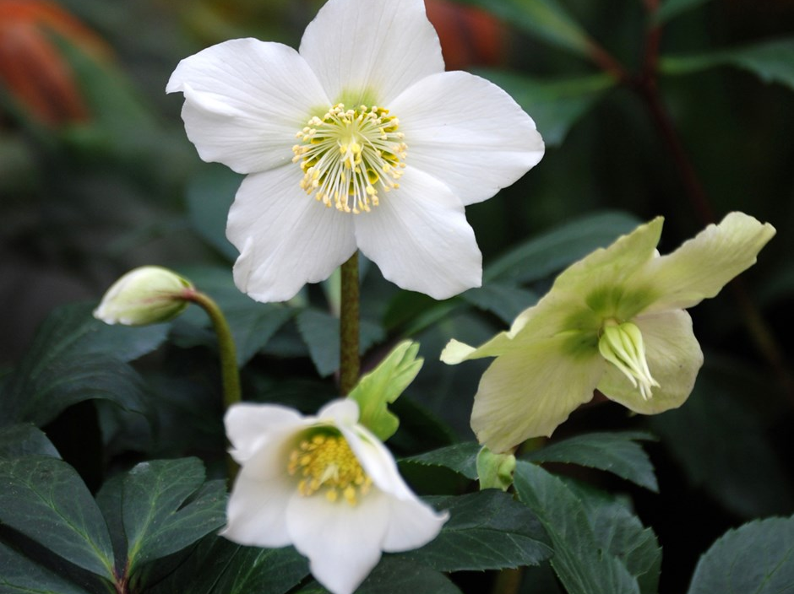
niger – black, dark
Helleborus niger
Common name – Christmas Rose

Slide 5
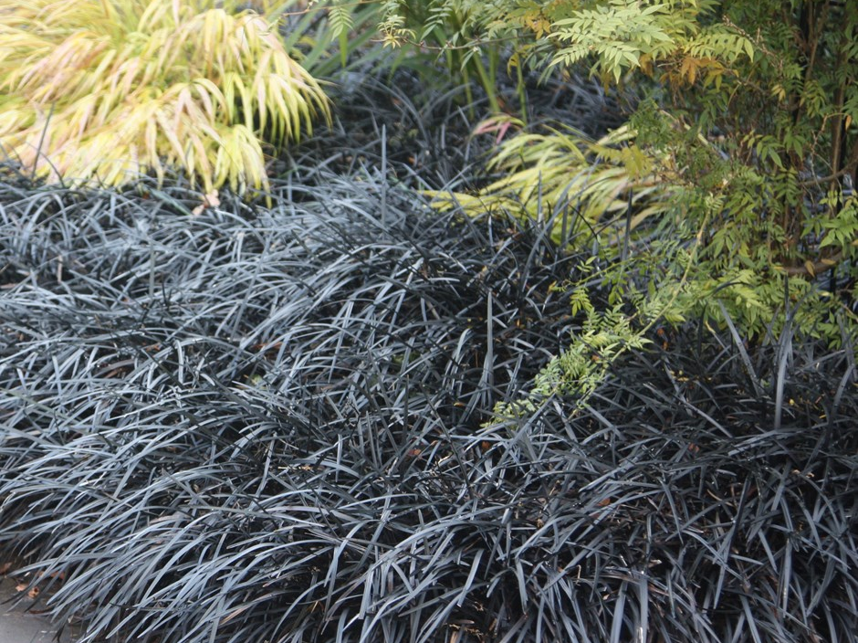
nigrescens – blackening, darkening
Ophiopogon nigrescens
Common name – Black Mondo Grass

Slide 6
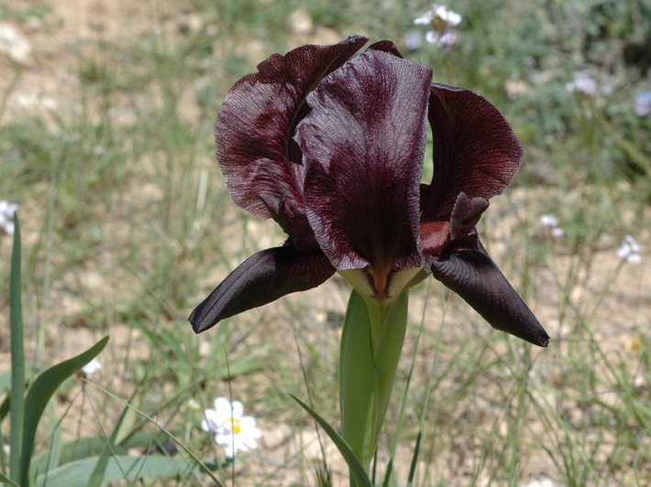
nigricans - blackish
Iris nigricans

Slide 7
WHITE
Betula alba
Cotoneaster lacteus
Galanthus nivalis
Philadelphus virginalis
alba
albicans
lacteus
nivalis
virginalis

Slide 8
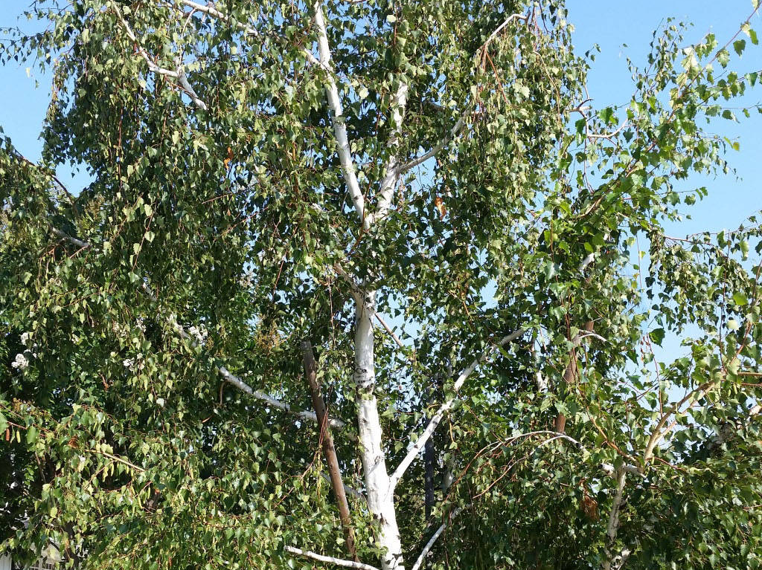
alba – white
Betula alba
Common Name – White Birch

Slide 9
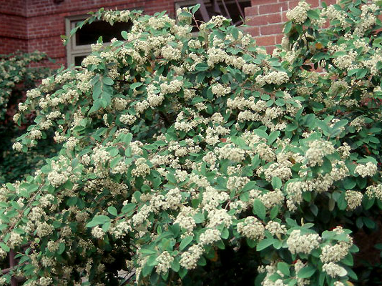
lacteus – of or pertaining to milk, milky
Cotoneaster lacteus
Common Name – Red Clusterberry, Parney Cotoneaster, Milkflower Cotoneaster

Slide 10
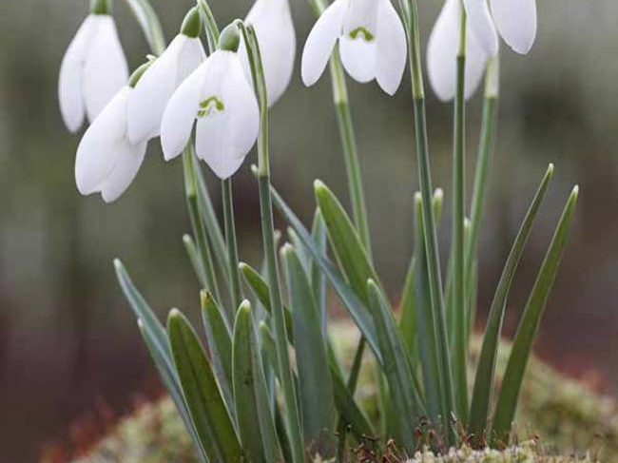
nivalis – snowy, snow-covered
Galanthus nivalis – for its snowy flowers
Common name – Snowdrop

Slide 11
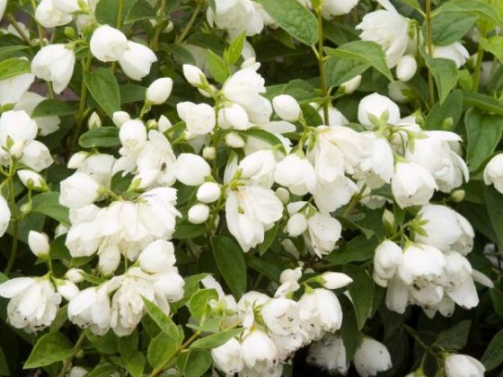
virginalis – maidenly; of or pertaining to a maiden or virgin
Philadelphus virginalis
Common Name – Mock Orange, Virginal Mock Orange

Slide 12
GRAY
Ceanothus griseus
Echinocactus cinereus
Helleborus lividus
griseus
cinereus
lividus

Slide 13
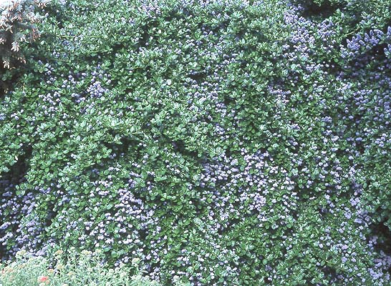
griseus - grey
Ceanothus griseus
Common Name – Yankee Point, Carmel Creeper, Carmel Ceanothus

Slide 14
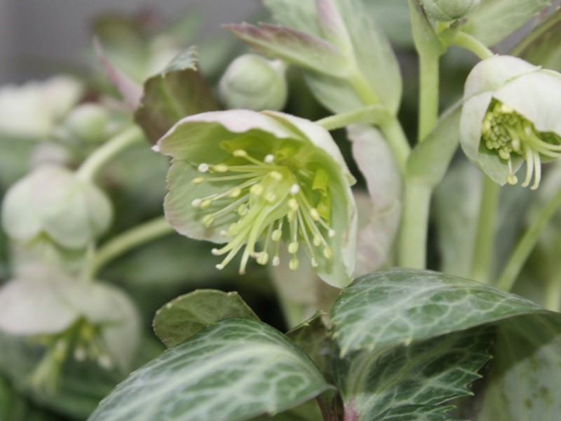
lividus – lead color, gray
Helleborus lividus
Common Name – Majorcan Hellebore

Slide 15
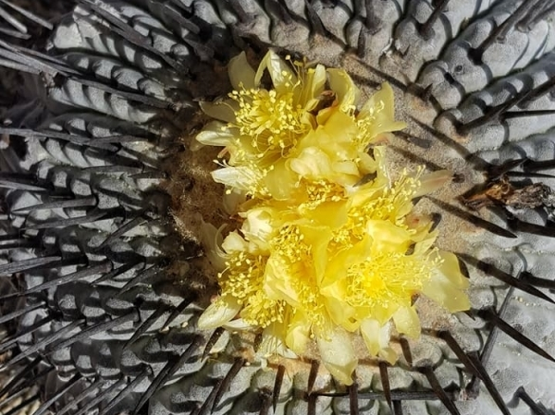
cinereus – ashen, like ashes
Echinocactus cinereus

Slide 16
REDS
Catharanthus roseus
Centranthus ruber
Ceanothus sanguineus
roseus
ruber
sanguineus

Slide 17
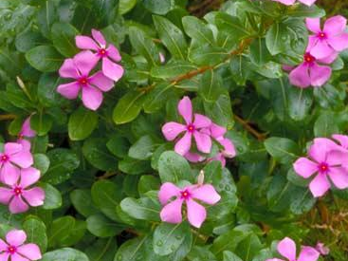
roseus – ink, rose-colored, rosy
Catharanthus roseus
Common Name – Old Maid, Madagascar Periwinkle

Slide 18
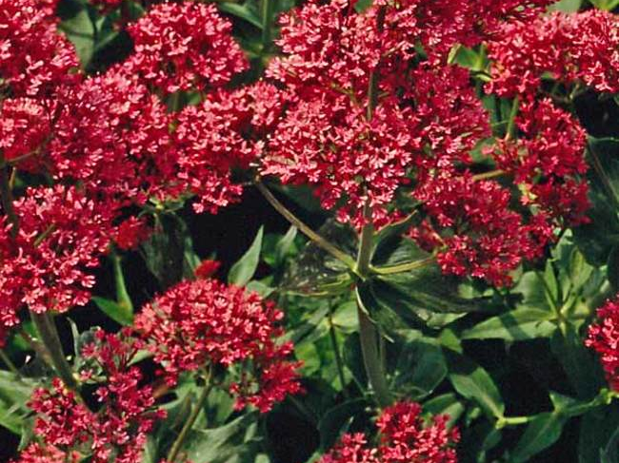
Ruber – red, ruddy
Centranthus ruber
Common Name – Red Valerian, spur valerian, kiss-me-quick, fox's brush, Devil's Beard and Jupiter's beard

Slide 19
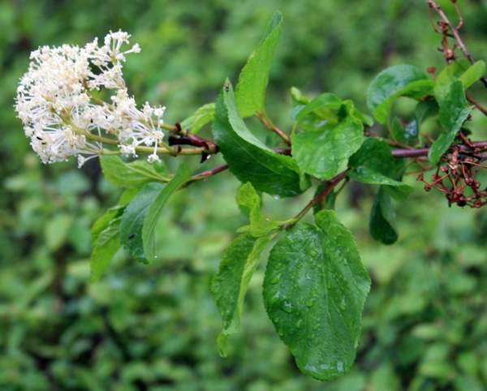
sanguineus – of blood, bloody, blood-coloured
Ceanothus sanguineus
Common Name – Red Stem Ceanothus

Slide 20
BLUES
Penstemon azureus
Trollius lilacinus
Cistus purpureus
azureus
lilacinus
purpureus

Slide 21
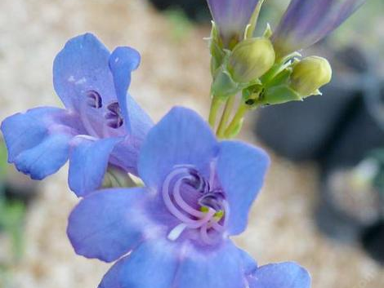
azureus – of a deep blue color
Penstemon azureus

Slide 22
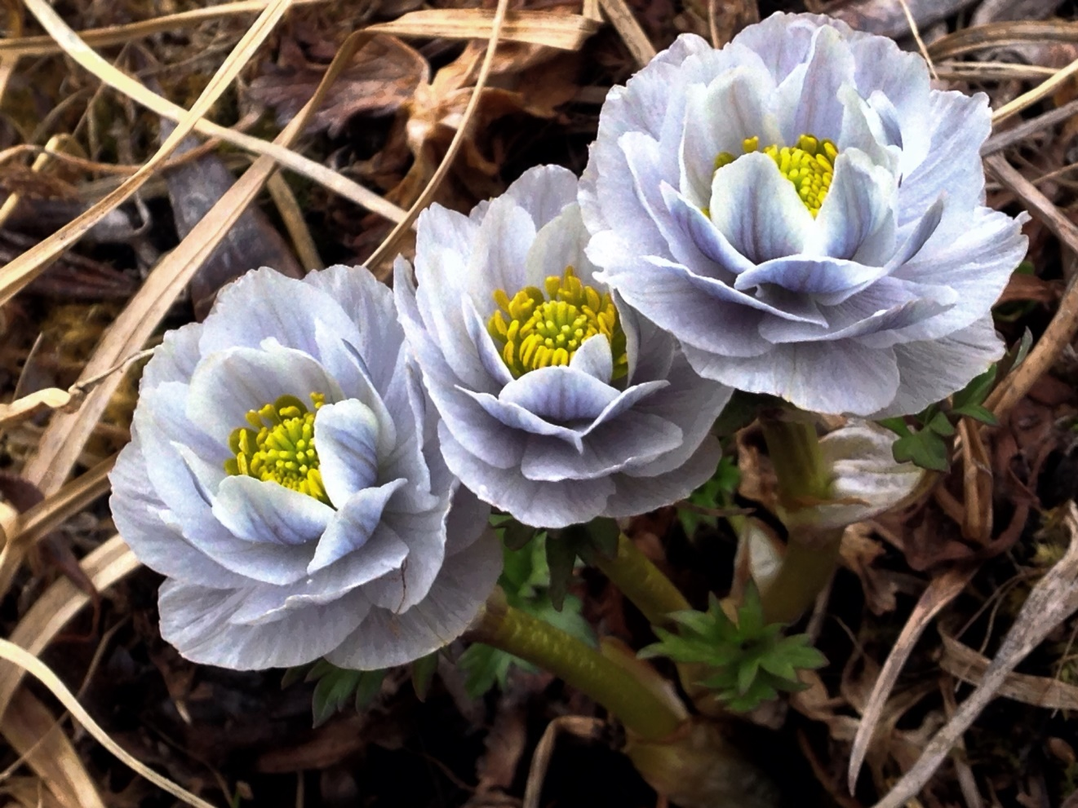
lilacinus – lilac-coloured
Trollius lilacinus

Slide 23
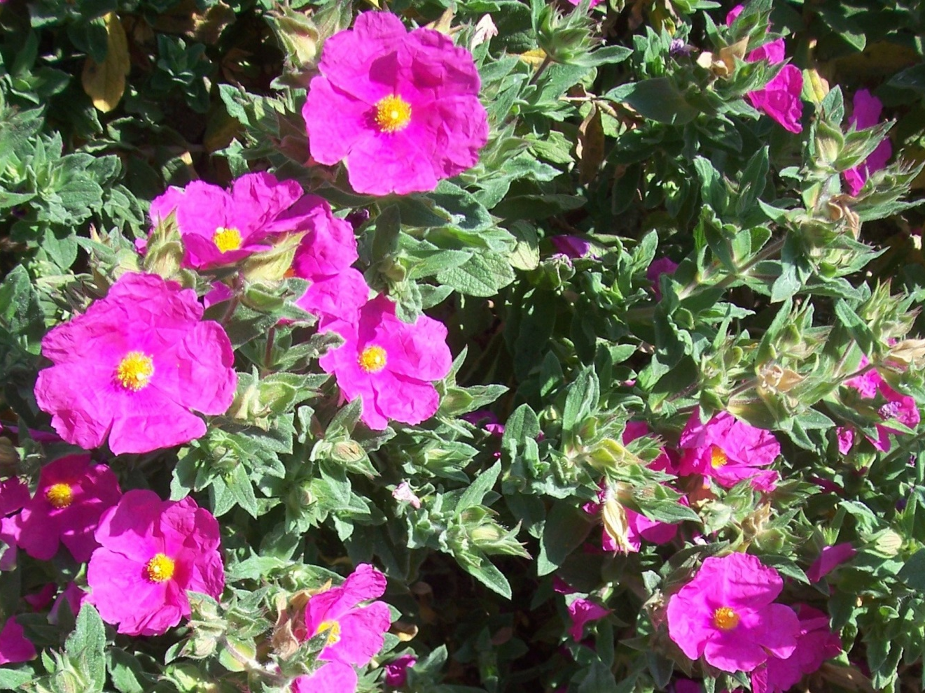
Purpureus – purple, clothed in purple
Cistus purpureus
Common Name – Rock Rose

Slide 24
YELLOWS
Erigeron aureus
Lupinus luteolus
Cosmos sulphureus
aureus
luteolus
sulphureus

Slide 25
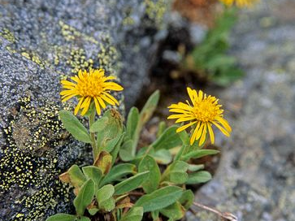
aureus - golden
Erigeron aureus
Common Name - Fleabane

Slide 26
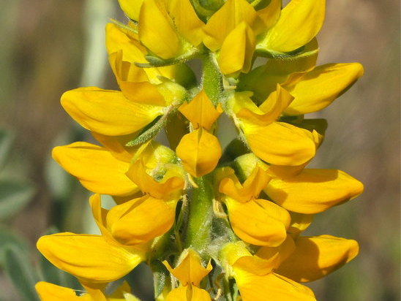
luteolus – yellowish
Lupinus luteolus
Common Name - Lupin

Slide 27
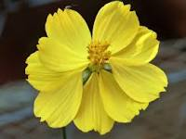
sulphureus – sulphur, pale yellow
Cosmos sulphureus

Slide 28
GREENS
Rosa glauca
Cupressus sempervirens
Crataegus viridis
glaucus
sempervirens
viridis

Slide 29
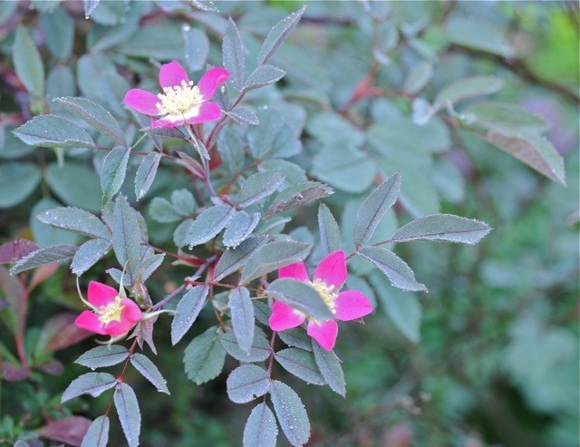
glauca – glaucous green, sea green
Rosa glauca

Slide 30
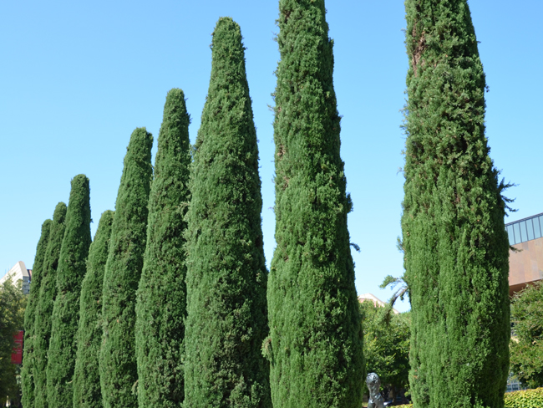
sempervirens – always green
Cupressus sempervirens
Common Name – Mediterranean Cypress

Slide 31
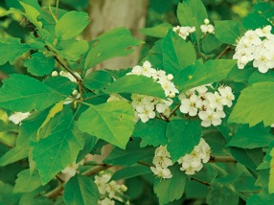
viridis - greenish
Crataegus viridis
Common Name - Green Hawthorn

Slide 32
NEXT TIME????
Markings - words like marginata
Flower Shape – words like stellatus
Leaf Shape – words like pungens
Plant Shape – words like frutescens

