Slide 1
LATIN FOR GARDENERS II
MARKINGS
FLOWER SHAPES
LEAF SHAPES
PLANT SHAPES

Slide 2
MARKING TERMS
Can mean markings on various parts of the plant – not just the leaves
marginata – edged, margined
pictum – painted
reticulata – netted, veined
variegatus - variegated

Slide 3
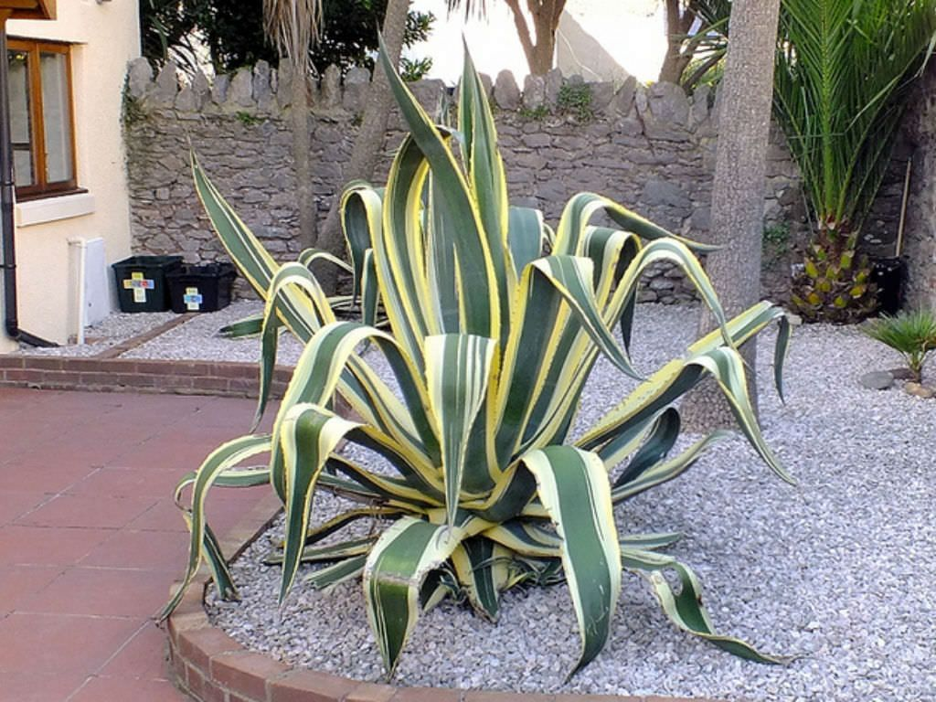
Agave americana ‘Marginata’
Common Name: Sentry Plant, Century Plant, Marguay and American Aloe
marginata – edged or margined

Slide 4
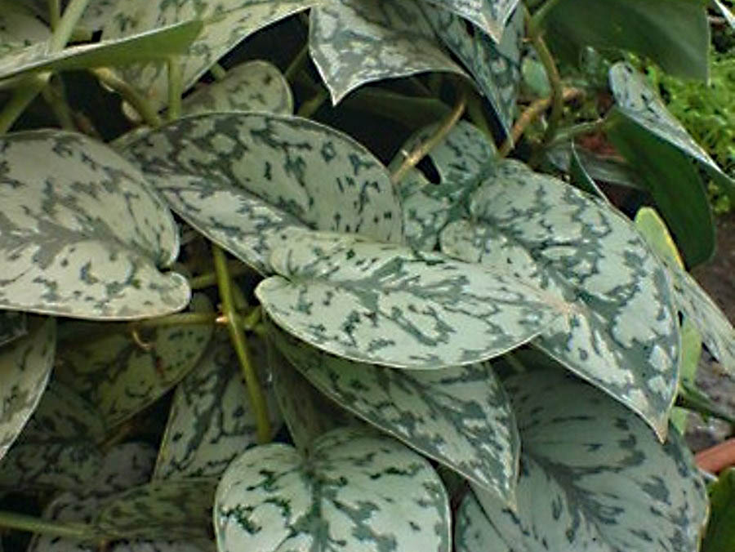
Scindapsus pictum
Common Name – Silver Vine or Satin Pothos
pictum - painted

Slide 5
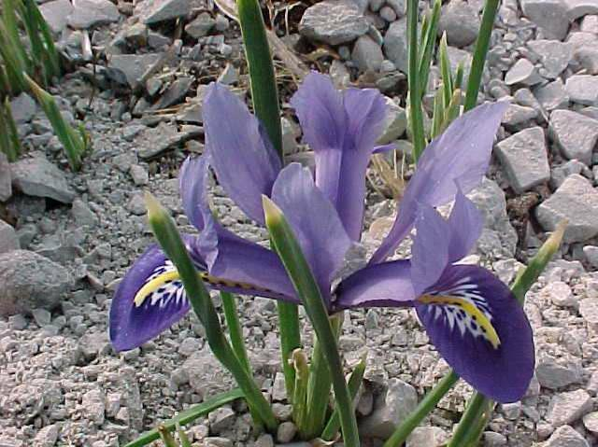
Iris reticulata
Common Names: Netted Iris, Golden Netted Iris
reticulata – netted, veined

Slide 6
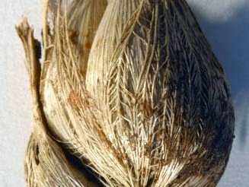
Iris reticulata bulb
The plant has the specific epithet reticulata because of the appearance of netting around the bulb

Slide 7
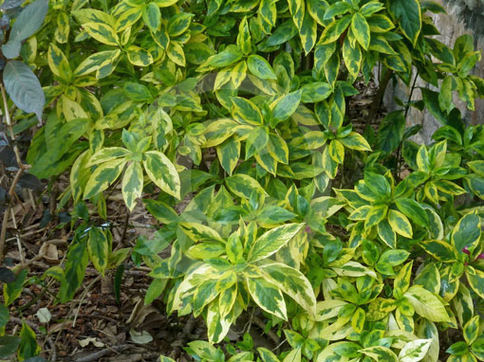
Graptophyllum pictum ‘Aurea-Marginata’
Common Name – Caricature Plant
pictum – painted
aurea – yellow or gold
marginata – margined or edged

Slide 8
Flower Shapes
SO MANY TO CHOOSE FROM!!
campanulatus – bell-shaped
flore-pleno – double-flowered
plumosus - feathery
ringens – two-lipped
stellatus – star-shaped

Slide 9
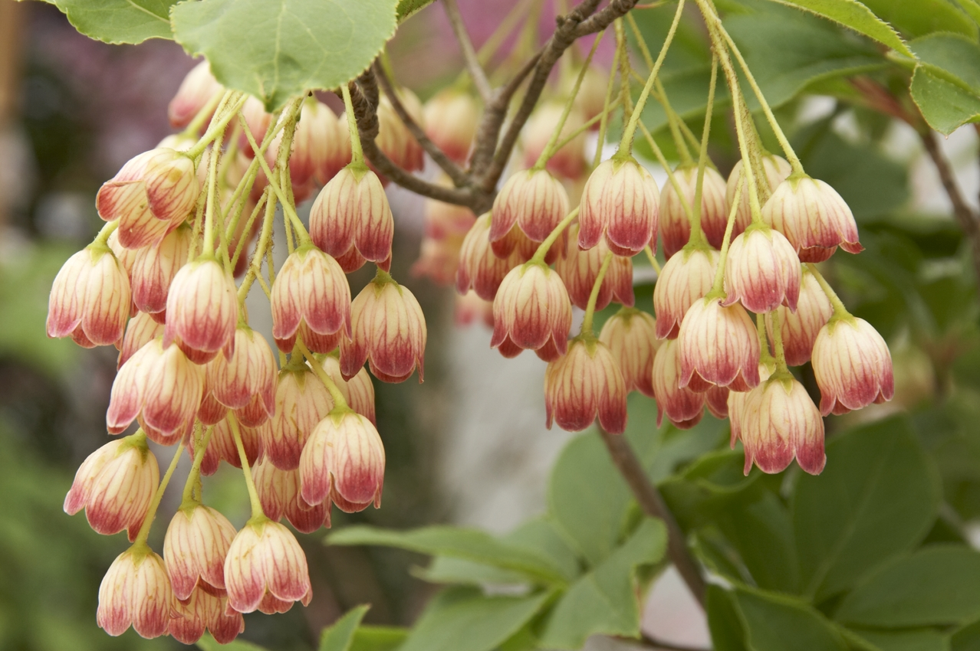
Enkianthus campanulata
Common Name – Red-Vein Enkianthus
campanulata – bell-shaped

Slide 10
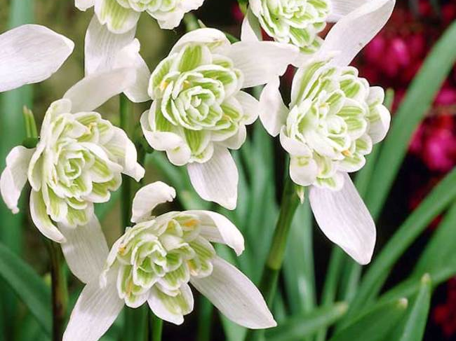
Galanthus nivalis flore-pleno
Common Name – Double Snowdrop
nivalis – snow-white
flore-pleno – double flowered

Slide 11
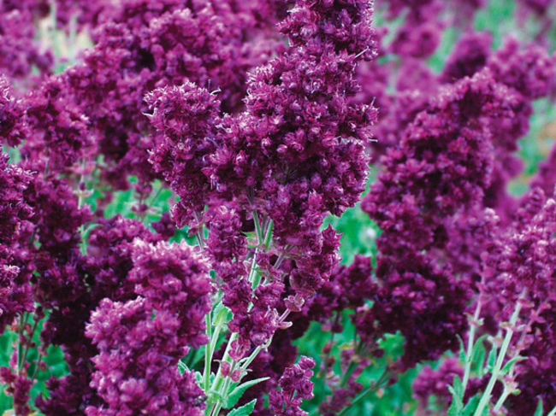
Salvia plumosa
Common Name – Double Salvia
plumosa - feathery

Slide 12
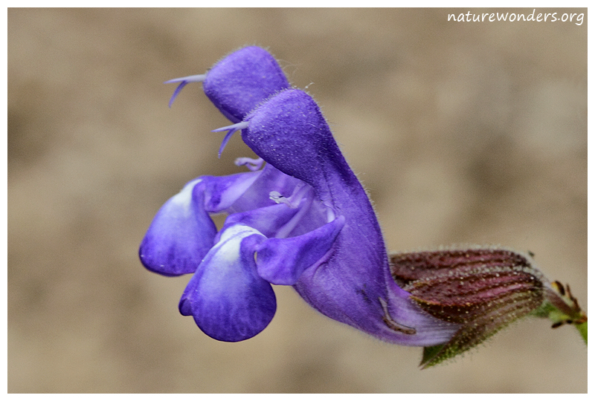
Salvia ringens
Common name – Mount Olympus Sage
ringens – two-lipped

Slide 13
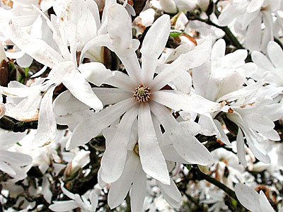
Magnolia stellata
Common Name – Star Magnolia
Stellata – star-shaped

Slide 14
Leaf Shapes
dentatus – toothed
digitalis – fingered, like digits
flabellatus – Fan-shaped
incisus – deeply cut
pungens - pointed

Slide 15
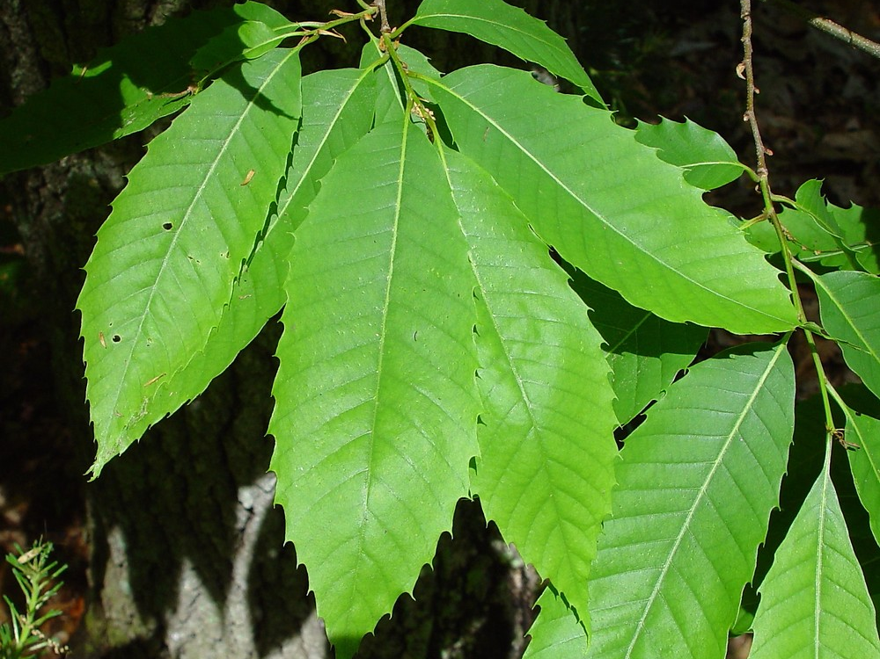
Castanea dentata
Common Name - American Chestnut
dentata - toothed

Slide 16
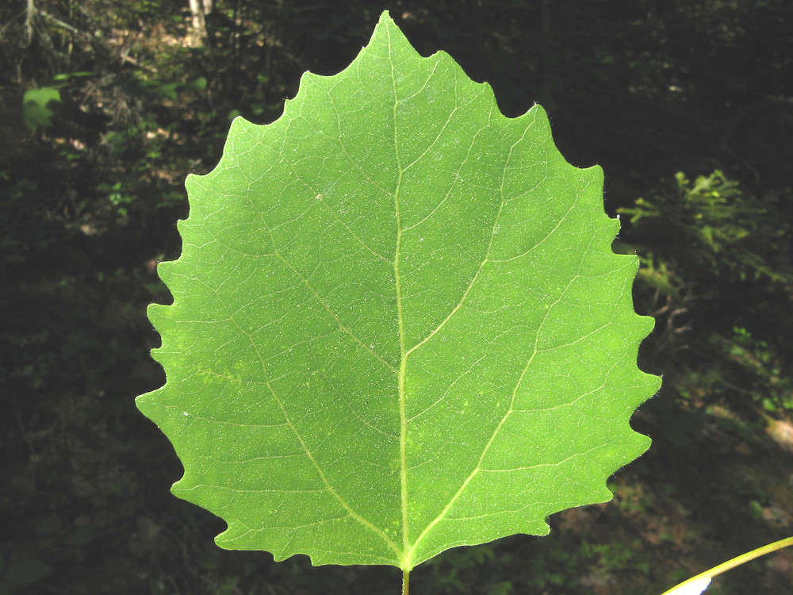
Populus grandidentata
Common Names – Large-tooth Aspen, Big-tooth Aspen, American Aspen, White Poplar
grandidentata – BIG toothed

Slide 17
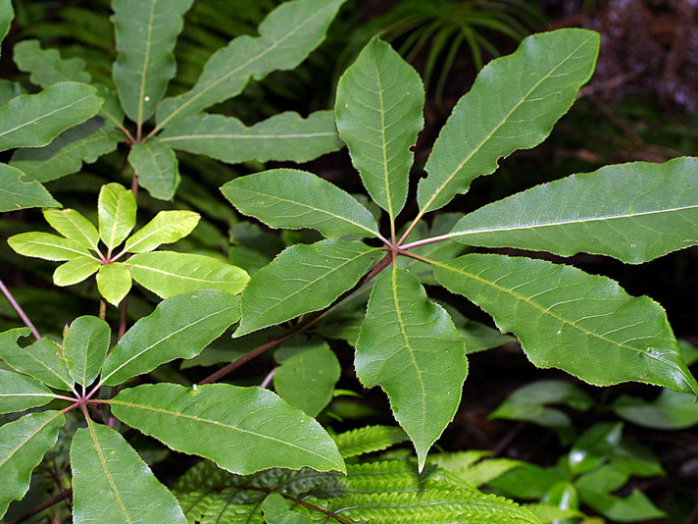
Schefflera digitalis
Common Names – Pate, Seven-finger, Umbrella Tree
digitalis - fingered

Slide 18
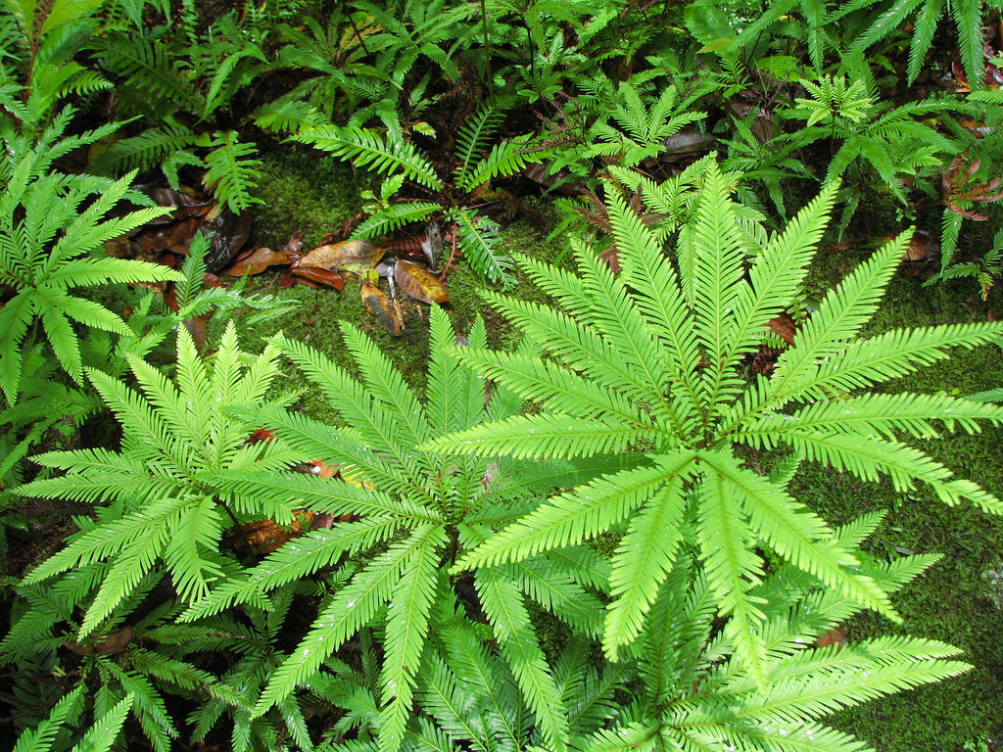
Sticherus flabellatus
Common Name – Umbrella Fern
flabellatus – fan-shaped

Slide 19
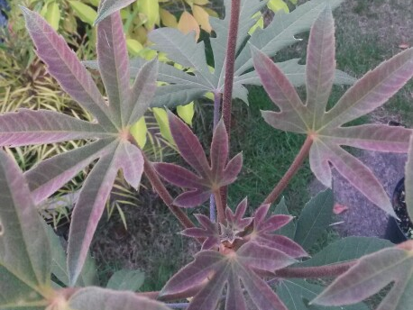
Oreopanex incisus
Common Name: El Candelabro (Candelabrum)
incisus – deeply cut

Slide 20
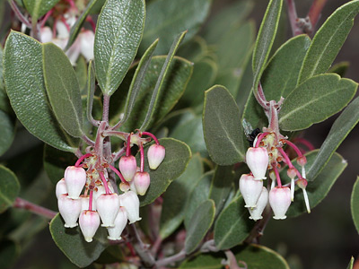
Arctostaphylos pungens
Common Name – Pointleaf Manzanita
pungens - pointed

Slide 21
Plant Shapes
alatus - winged
deflexus – turned sharply downward or bending outward
fastigiatus – with upright branches
reptans - creeping

Slide 22
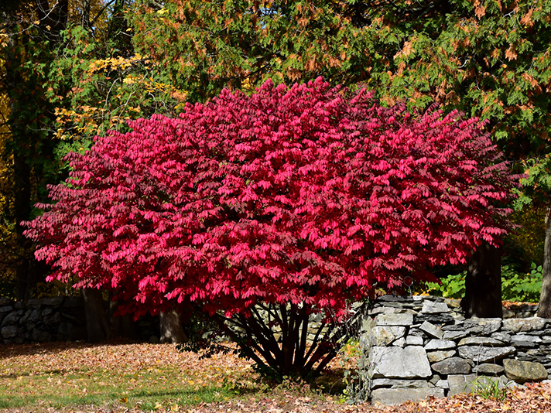
Euonymus alatus
Common Name – Winged Burning Bush
alatus - winged

Slide 23
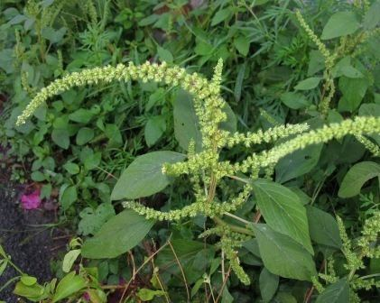
Amaranthus deflexus
Common Names: Large-fruit Amaranth, Low Amaranth, Argentina Amaranth, Perennial Pigweed
Deflexus – turned sharply downward or bending outward

Slide 24
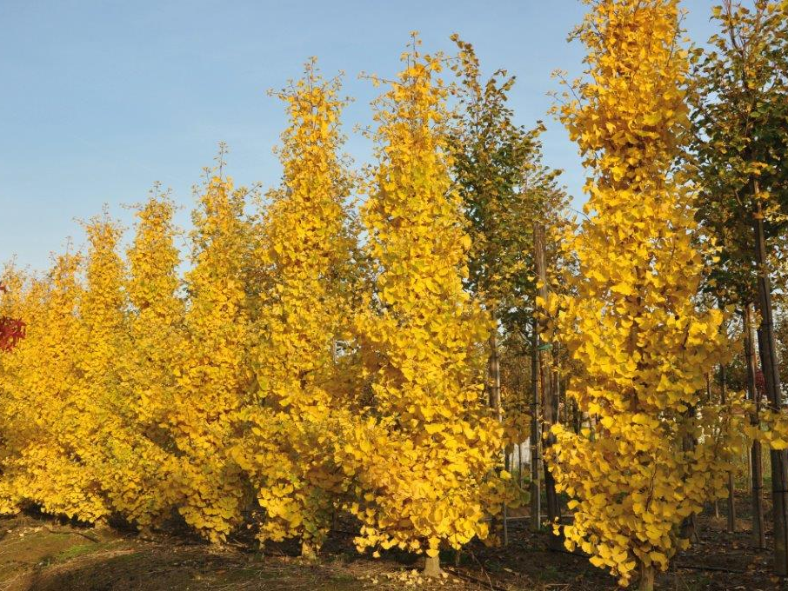
Ginkgo biloba fastigiata
Common Name – Maidenhair Tree
fastigiata – with upright branches

Slide 25
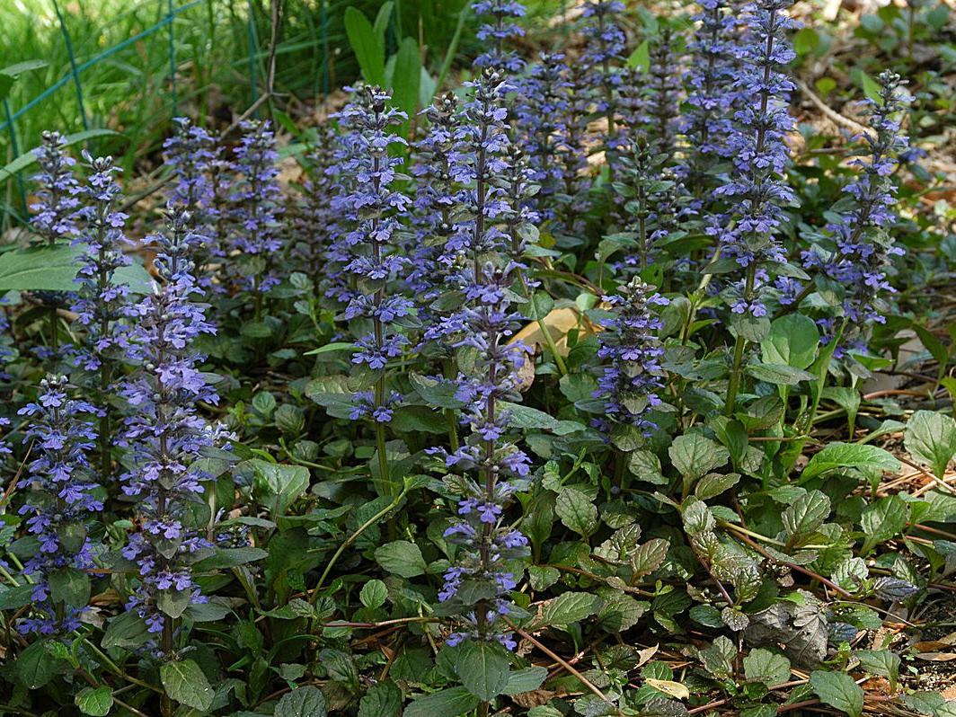
Ajuga reptans
Common Names: Bugle, Blue Bugle, Bugleherb, Bugleweed, Carpetweed, Carpet Bugleweed
reptans - creeping

Slide 26
NEXT TIME??
A focus on words used to describe:
Texture
Size
Direction

