Slide 1
LATIN FOR GARDENERS III
Texture
Size
Direction
Fragrance & Taste

Slide 2
TERMS FOR TEXTURE
These terms describe the way a plant looks and/ or feels to the touch:
barbatus – bearded
hirsutus – hairy
lanatus - wooly
rugosus - wrinkled

Slide 3
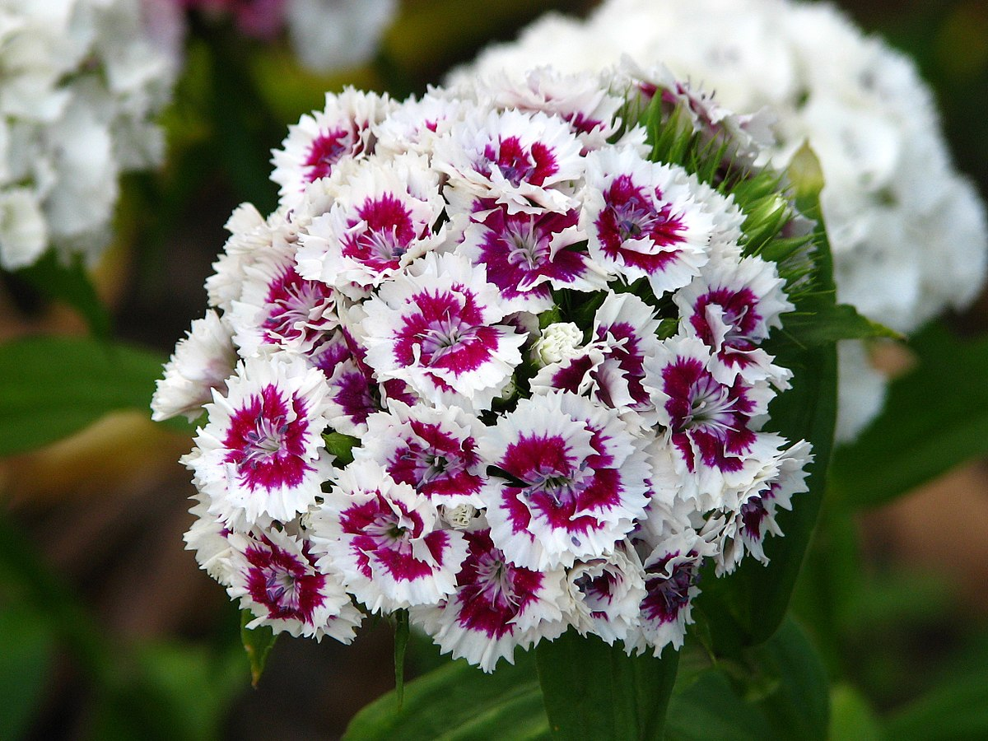
Dianthus barbatus
Common name – Sweet William
barbatus – bearded
Named for the “bearded” growth in the flower center

Slide 4
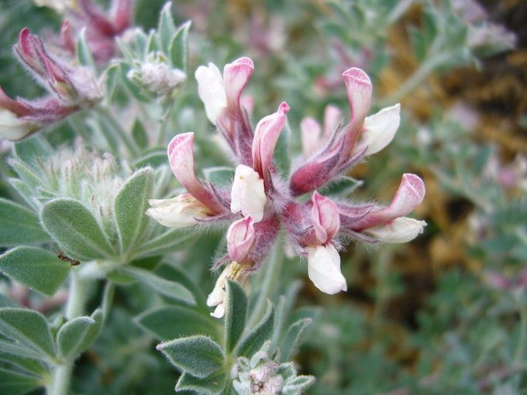
Dorycnium hirsutum
Common names: Hairy Canary Flower, Canary Clover, or Hairy Canary Clover
hirsutum – hairy, shaggy or bristly

Slide 5
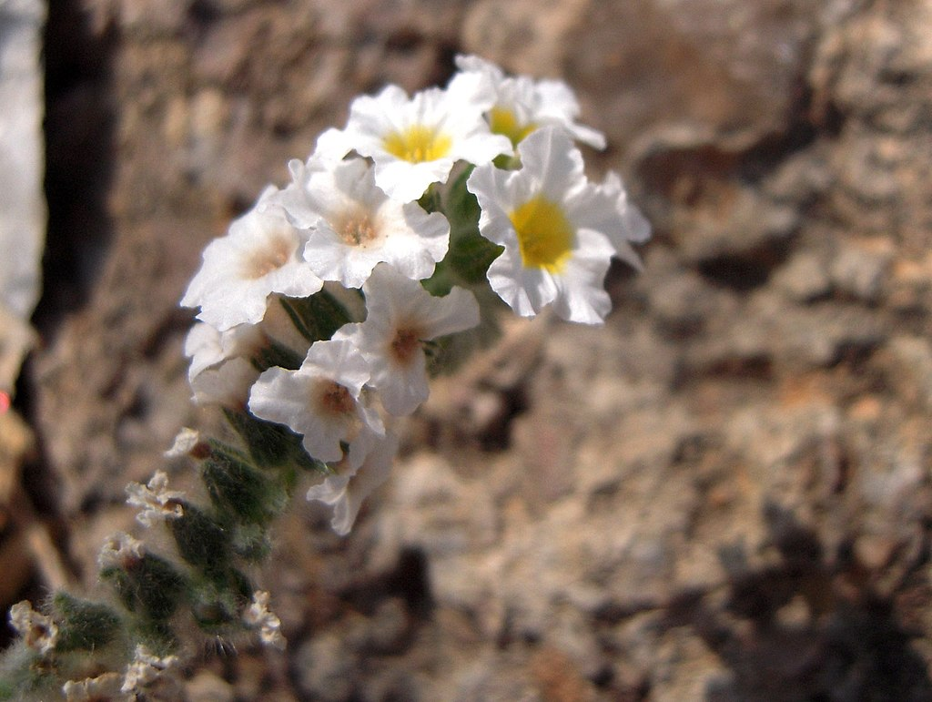
Heliotropium hirsutissinum
hirsutissinum – VERY hairy

Slide 6
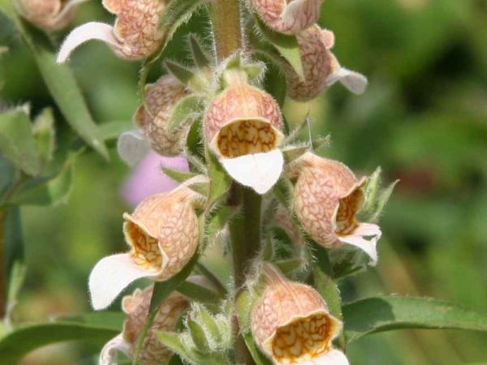
Digitalis lanata
Common names: Wooly foxglove, Grecian foxglove
lanata – wooly
This plant is covered with white hairs on the underside of the leaves and on flowers and stems

Slide 7
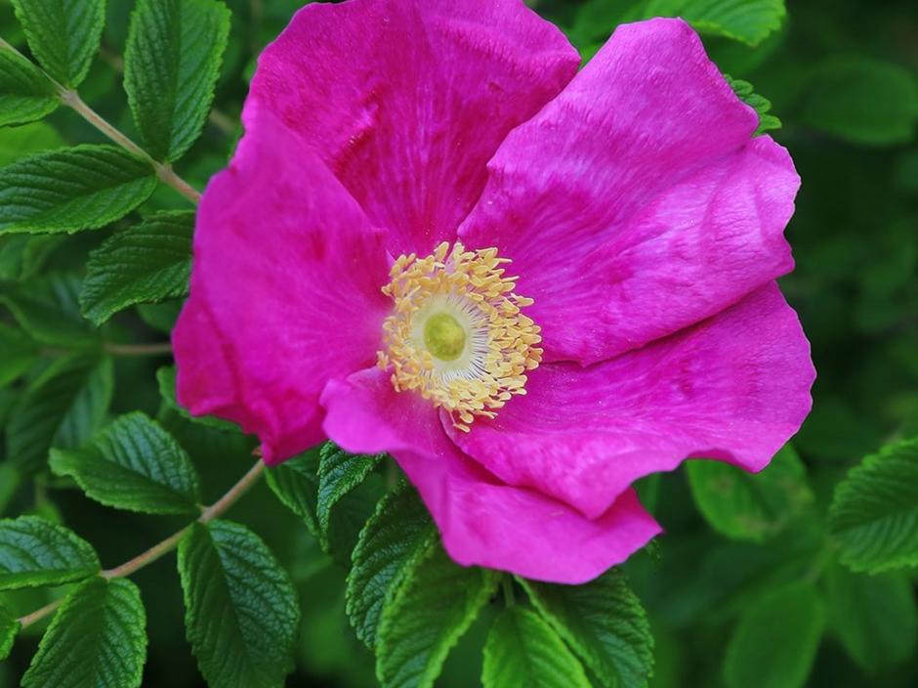
Rosa rugosa
Common names: red Japanese Rose, Rugosa Rose, Beach Rose, or Ramanas Rose
rugosa - wrinkled

Slide 8
SIZE
Maximus – largest
Obesus – fat, succulent
Parvulus – very small
Tenuis – thin, slender

Slide 9
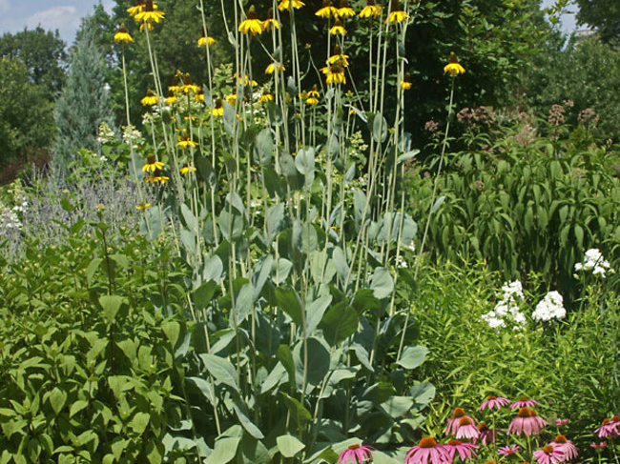
Rudbeckia maxima
Common Name: Giant Coneflower, Large Coneflower, Cabbage Leaf Coneflower
maximus - largest

Slide 10
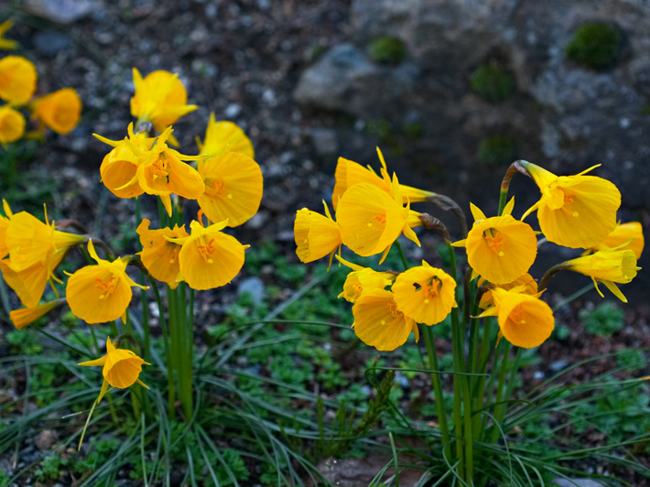
Narcissus obesus
Named for their large “hoop petticoats” and because the flowers are so much larger than other species of narcissus
obesus – fat, succulent

Slide 11
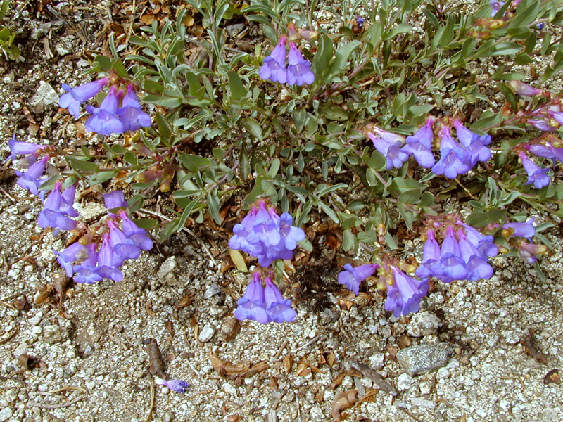
Penstemon parvulus
Common name: Small Penstemom
parvulus – very small
Native perennial herb in Central and Northern Caifornia

Slide 12
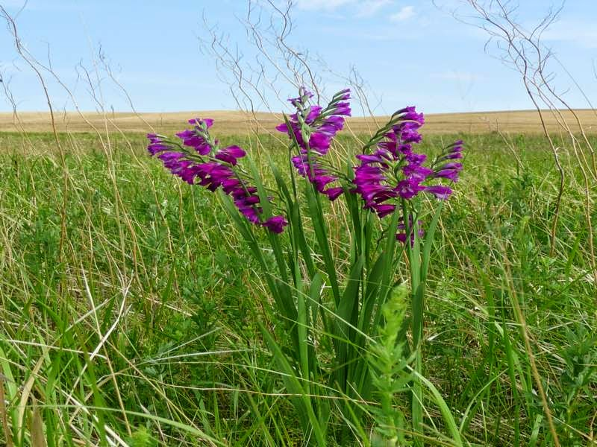
Gladiolus tenuis
Common name: Thin Gladiolus
tenuis – thin, slender

Slide 13
DIRECTION
These terms can refer to the whole plant or just parts of a plant
Horizontalis - horizontal
Pendulus – hanging, pendulous
Tortilis - twisted
Tortuosus - meandering

Slide 14
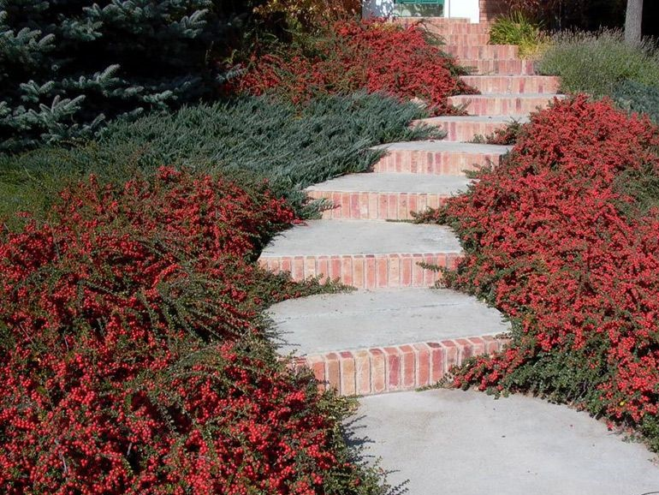
Cotoneaster horizontalis
Common Name: Rockspray Cotoneaster
horizontalis – horizontal, flat to the ground

Slide 15
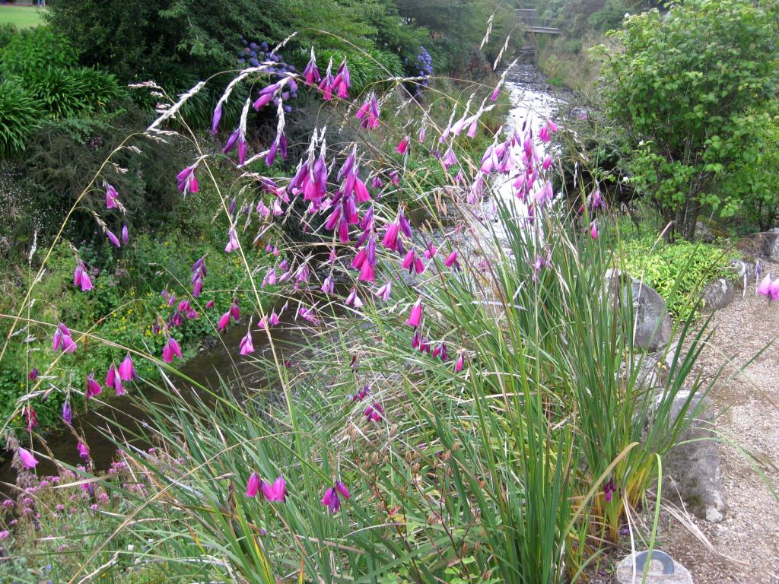
Dierama pendula
Common Names: Fairy Bell, Hair Bell, Wedding Bell, Fisherman’s wand, Fairy Wand, Angel’s Fishing Rod
pendula – hanging, pendulous

Slide 16
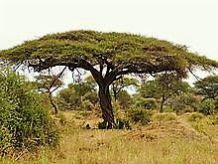
Vachellia tortilis or Acacia tortilis
Common Names – Desert Umbrella Acacia, Umbrella Thorn Tree, Israeli Babool, etc., etc., etc.
tortilis – twisted

Slide 17
Why Binomial Nomenclature is so helpful!
Vachellia tortilis is known by a wide number of common names. These include but are not limited to:
Afrikaans: haak-en-steek
Arabic: sunut, samar, sammar, samor, samra, sayyal, seyal, seyyal
English: karamoja, umbrella thorn
Hebrew: shitat ha'sochech
Hindi: Israeli babool
Italian: acacia ad ombrello
Kamba: mùgaa
Ndebele: isanqawe, umsasane, umshishene, untshatshatsha
Nyanja: mzunga, nsangu, nsangunsangu, nyoswa
Samburu: ltepes
Somali: qudhac
Spanish: Acacia de copa plana
Swahili: mgunga, mugumba, munga
Tigrigna: akba, akiba, alla, aqba
Tongan: mukoka, muzungu, ngoka
Tswana: mosu, mosunyana
Wolof: séng
Zulu: umSasane
Oromo: Lafto
Amharic: Grar

Slide 18
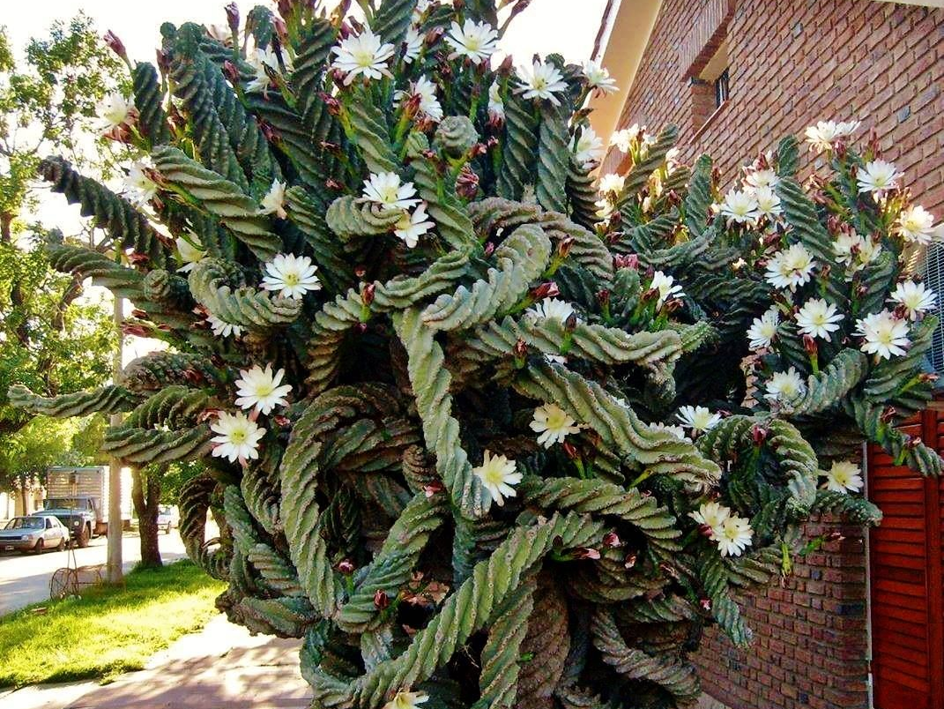
Cereus peruvianus tortuosus
Common Names: Twisted Cereus, Spiraled Cereus, Contorted Cereus ‘Spiralis’
tortuosus - twisted

Slide 19
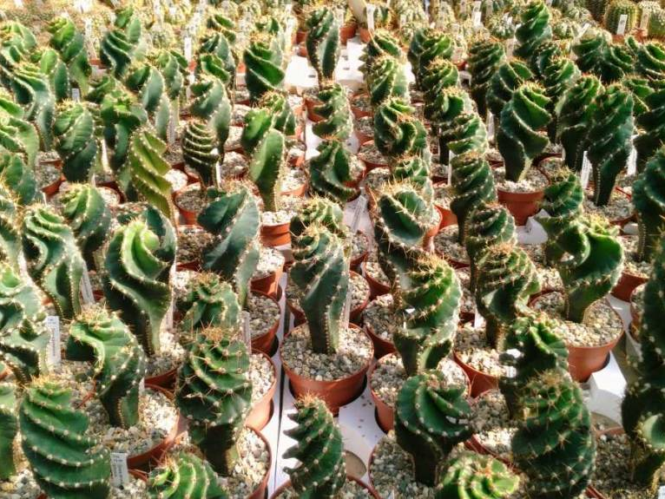
In case you wanted to start growing one…

Slide 20
FRAGRANCE & TASTE
Most specific epithets refer to appearance but sometimes the fragrance or taste of a plant deserves attention.
Citrodorus – lemon-scented
Foetidus – stinking, foetid
Inebrians –inebriating, intoxicating
Saccharinum – sweet, sugary
Succulentus – succulent, juicy

Slide 21
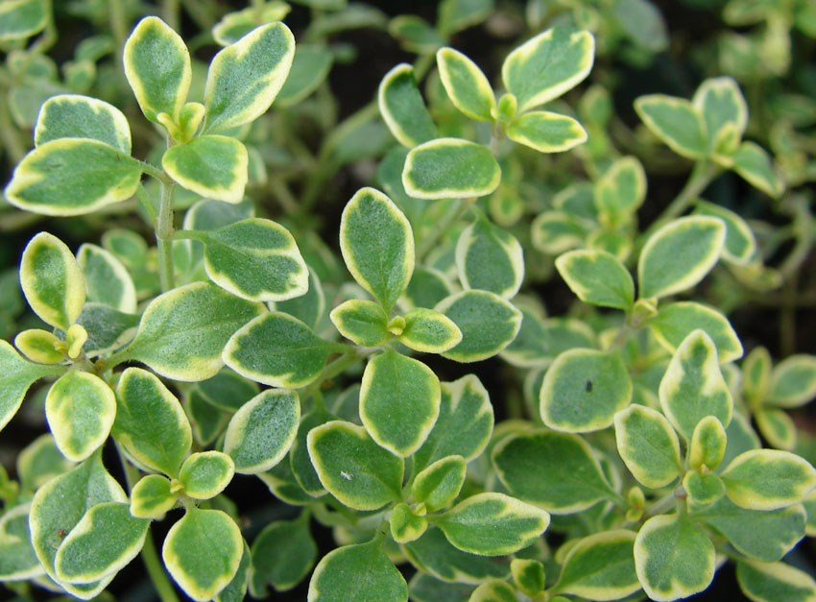
Thymus citrodorus
Common Name: Lemon Thyme or Citrus Thyme
citrodorus – lemon-scented

Slide 22
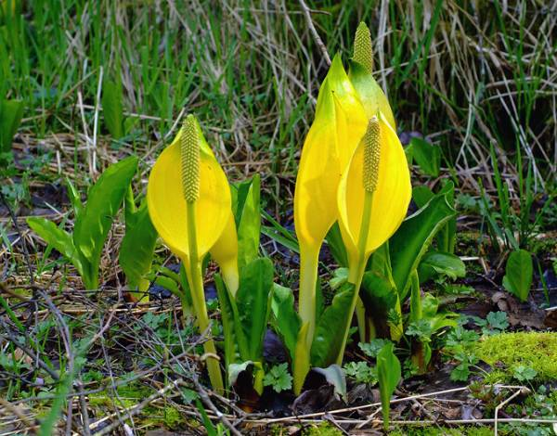
Symplocarpus foetidus
Common Names: Skunk Cabbage, Eastern Skunk Cabbage, Swamp Cabbage, Clumpfoot Cabbage, Meadow Cabbage, Foetid Pothos and Polecat Weed
Bruising the leaves gives off a skunk-like smell.
foetidus – stinking, foetid

Slide 23
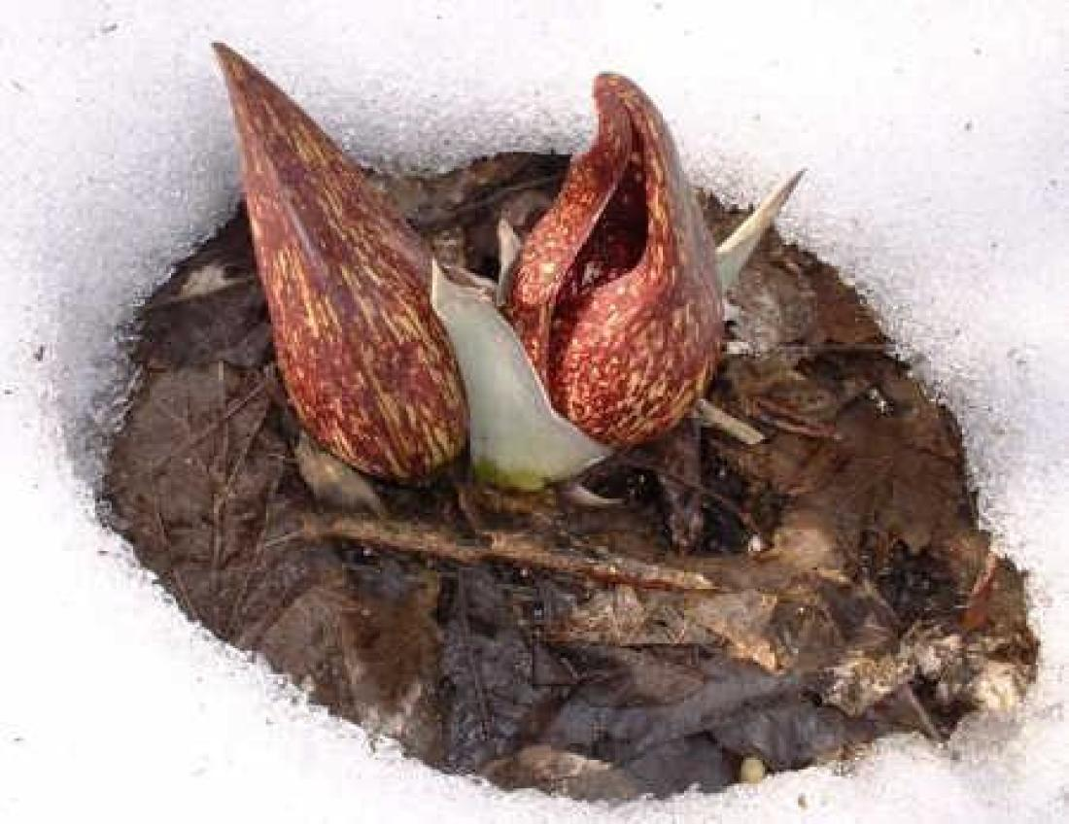
Symplocarpus foetidus
Thermogenic properties of this plant enable it to generate temperatures between 27 – 63 degrees Fahrenheit higher than the surrounding air temperature.

Slide 24
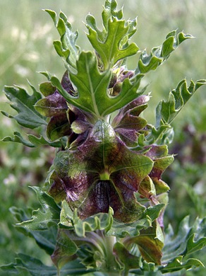
Lagochilus inebrians
Common Names: Inebriating Mint, Intoxicating Mint, Turkistan Mint, Intoxicating Hare’s Lip
inebrians – inebriating, intoxicating
Used for its intoxicating properties when made into a tea with sugar and/or honey by Tajik, Tartar, Turkoman and Uzbek tribesmen.

Slide 25
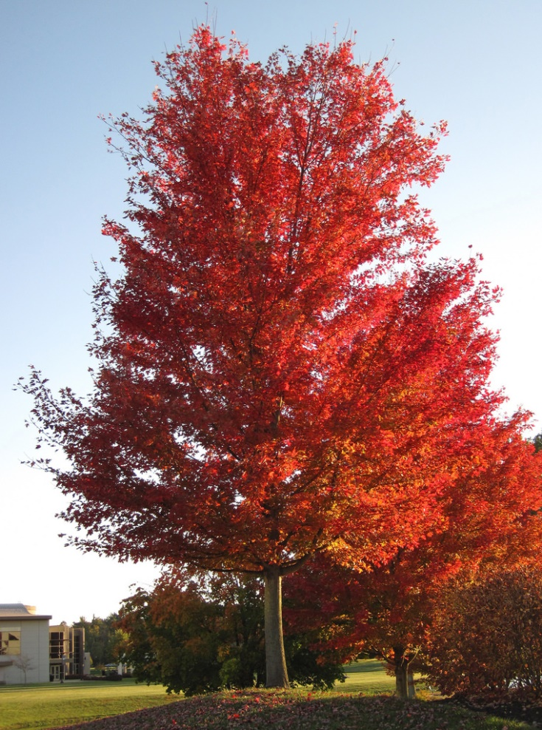
Acer saccharinum
Common Names: Silver Maple, Soft Maple, River Maple, Water Maple
saccharinum – sweet, sugary
Named for its light, semi-sweet sap….not to be confused with…

Slide 26
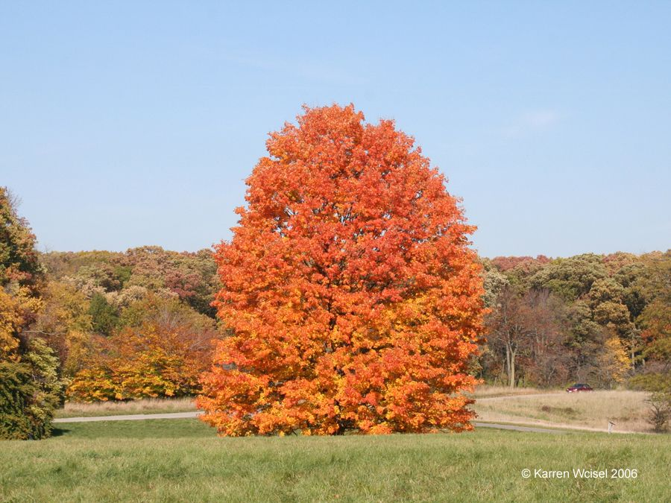
Acer saccharum
Common Names: Sugar Maple, Rock Maple
saccharum – sugar
Saccharum is the genus name for sugarcane. The sap of Acer saccharum is sweeter and better for syrup making than that of Acer saccharinum.

Slide 27

Lupinus succulentus
Common Names: Hollowleaf Annual Lupine, Arroyo Lupine, Succulent Lupine
succulentus – succulent, juicy
Leaflets are unusually wide, almost succulent in nature. Plant favors soil with high moisture content.

Slide 28
NEXT TIME??
Flowering Time
Mountainous Habitats
Woodland Habitats
Open Land Habitats
Wetland Habitats

