Slide 1
LATIN FOR GARDENERS IV
FLOWERING TIME
HABITAT

Slide 2
FLOWERING TIME
The obvious…annuis, biennis and perennis
Vernalis – spring
Aestivalis – summer
Autumnalis – fall
Brumalis – winter
Majalis – May-flowering
Meridionalis – noon, midday

Slide 3
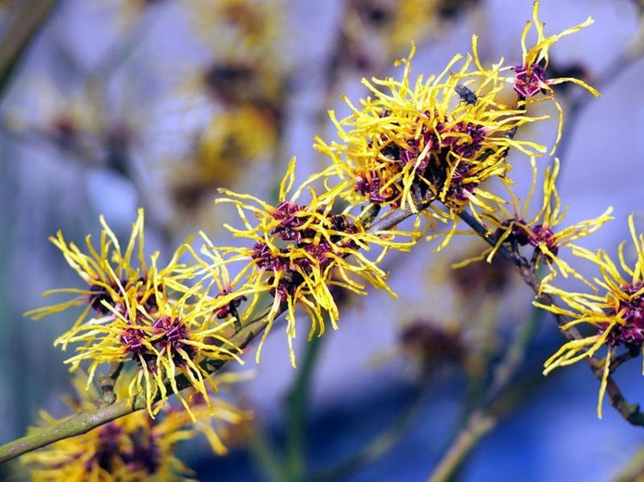
Hamamelis vernalis vernalis – spring-flowering
Common names: Ozark Witchhazel, Vernal Witchhazel
Blooms in winter or early spring before leaf emergence

Slide 4
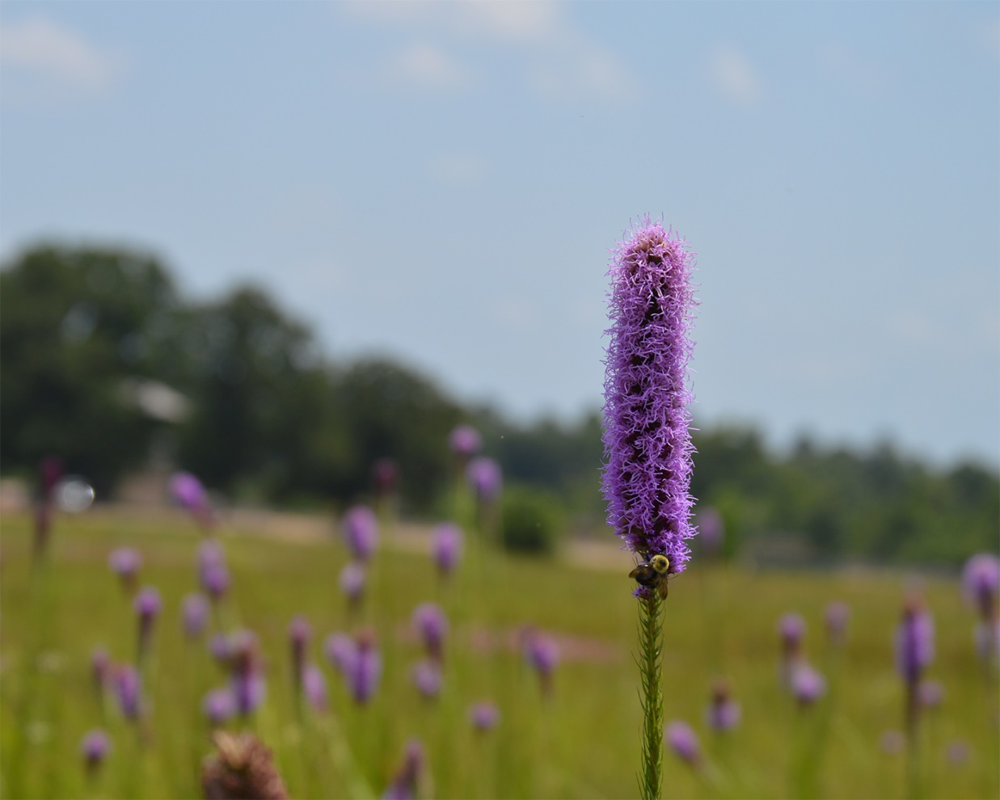
Liatris aestivalis aestivalis – summer-flowering
Common name – Summer Gayfeather
Native to Oklahoma and Texas – flowers in July and August and sometimes into September

Slide 5
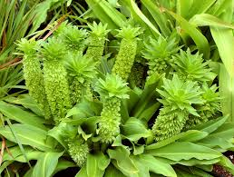
Eucomis autumnalis autumnalis – autumn-flowering
Common Name – Autumn Pineapple Flower, Autumn Pineapple Lily
Native to Malawi, Zimbabwe and Southern Africa
Used in Africa for its many medicinal qualities

Slide 6
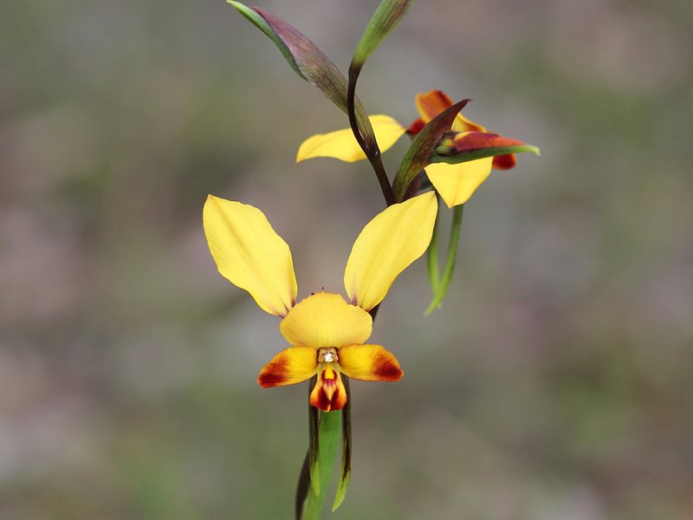
Diuris brumalis brumalis – winter-flowering
Common Name – Winter Donkey Orchid
Native to southwestern portion of Western Australia
One of the first to flower each year in this area

Slide 7
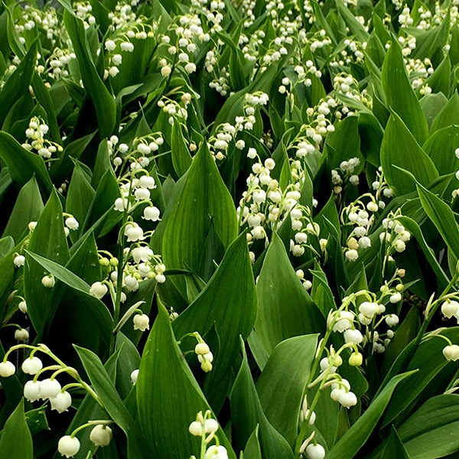
Convallaria majalis majalis – May-flowering
Common Names: Lily –of-the-Valley, May bells. Our Lady’s tears, Mary’s tears
A beautiful plant for shade but all parts of the plant are highly poisonous

Slide 8
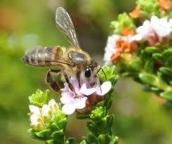
Euchaetis meridionalis I. Williams meridionalis – noon, mid-day
Common Name – Agulhas bearded-buchu
A hardy shrublet from South Africa which is long-lived and alive with bees when blooming

Slide 9
HABITATS
Mountainous
Wetland
Woodland
Open Land

Slide 10
MOUNTAINOUS HABITAT
algidus – cold, mountainous
frigidus – growing in cold habitats
saxatilis – growing on rocks
convallaria – growing in valleys

Slide 11
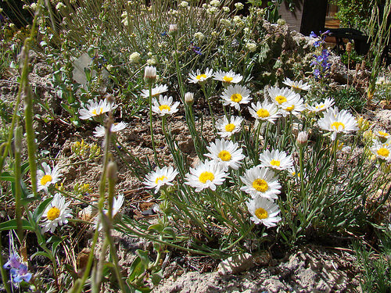
Erigeron algidus algidus – cold, mountainous
Common Name – Stalked Fleabane
Flowering plant native to the High Sierra and peaks of western Nevada and eastern California

Slide 12
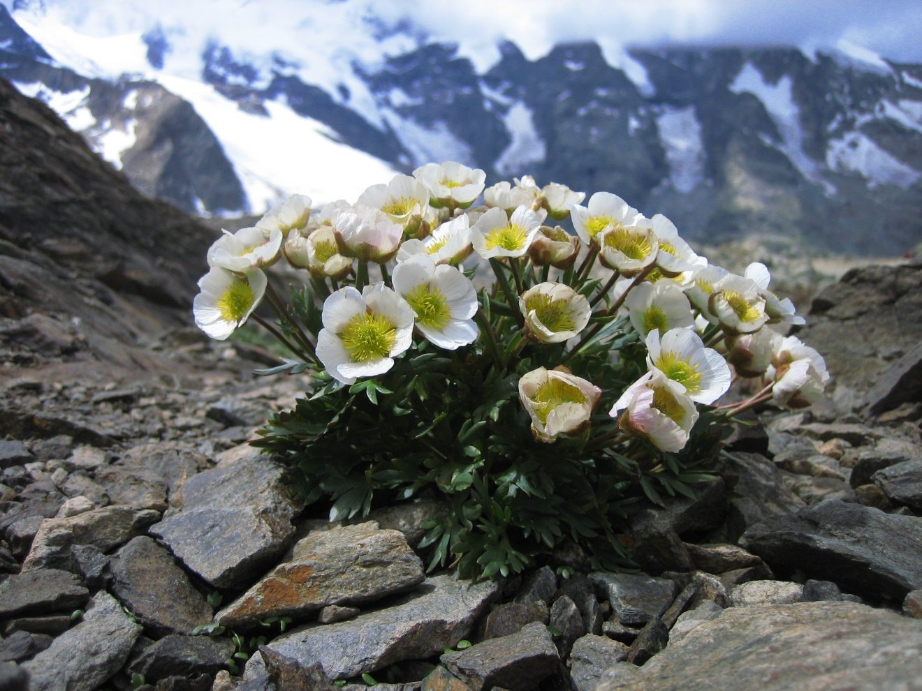
Ranunculus glacialis glacialis – of icy habitats
Common Names: Glacier Buttercup, Glacier Crowfoot
Arctic-alpine species found in the high mountains of Southern Europe – known as one of the highest-ascending plants in the Alps, found at over 12,000 ft.

Slide 13
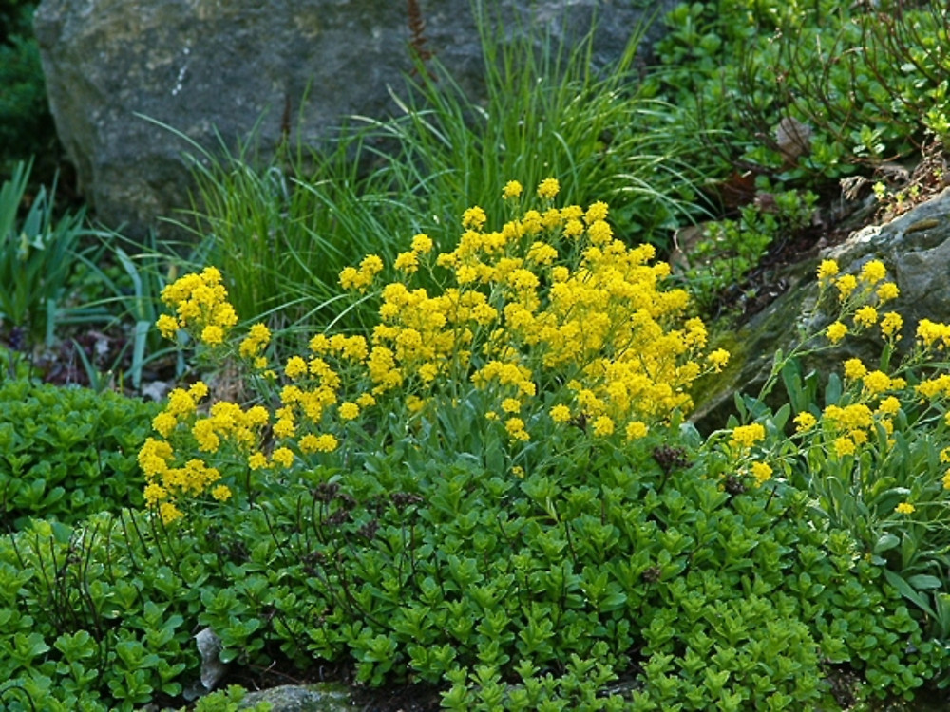
Aurinius saxatilis
Common Names: Basket of gold, Goldentuft Alyssum, Golden Alyssum, Golden Alison, Gold-Dust, Golden-Tuft Alyssum,, Golden-Tuft Madwort , Rock Madwort
This evergreen perennial that thrives in rocky, mountainous environs is ideal for a rock garden or for edging as long as it has great drainage.

Slide 14
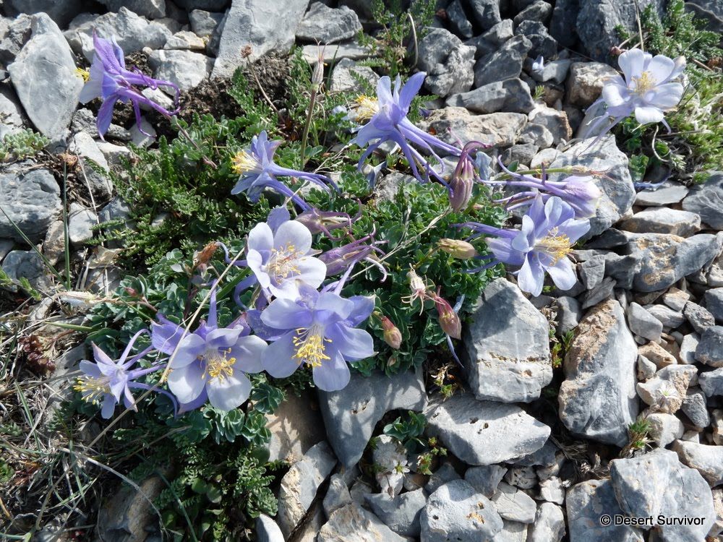
Aquilegia scopulorum scopulorum – growing on rock faces or cliffs
Common Name: Utah Columbine
This wildflower occurs in high elevation rocky habitats dominated by limestone.

Slide 15
WOODLAND HABITAT
nemoralis – of woods
sylvestris – of woods

Slide 16
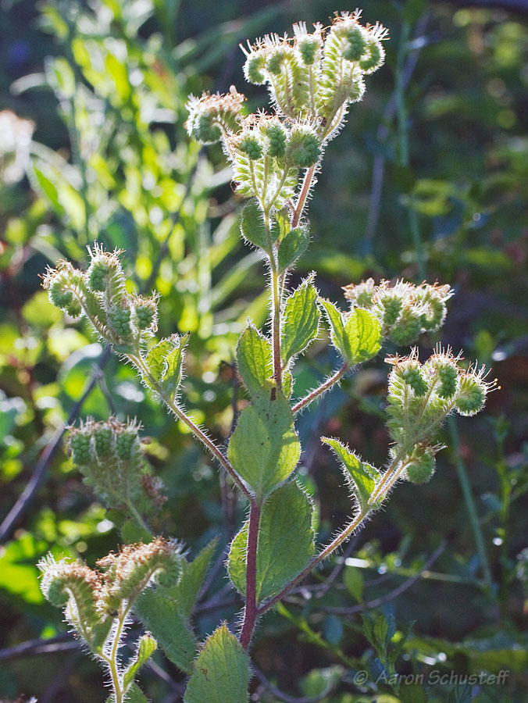
Phacelia nemoralis nemoralis – of woods
Common Name: Shade Phacelia
Common to wet shady forests of the US West Coast from Washington to central California

Slide 17
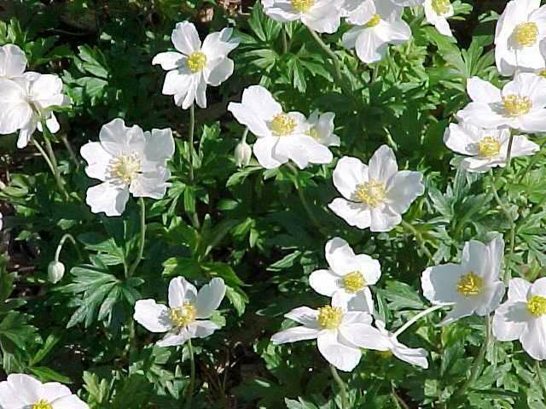
Anemone sylvestris sylvestris – of woods
Common Name: Snowdrop Windflower
A forest-loving spring-blooming anemone that is at home in the shaded woodland garden

Slide 18
OPEN LAND HABITAT
aridus – dry habits
arvensis – of plowed fields
campestre – open fields, pasture
pratensis – of meadows
siliceus – growing on sand

Slide 19
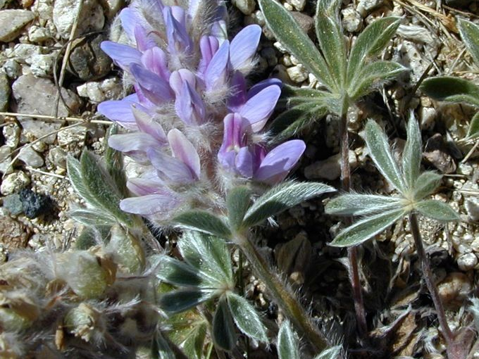
Lupinus aridus aridus – dry habitats
Common Names: Desert Lupine, Dry Ground Lupine, Prairie Lupine, Arid Lupine
Small lupine found from south-central Washington to northern California east of the Cascades

Slide 20
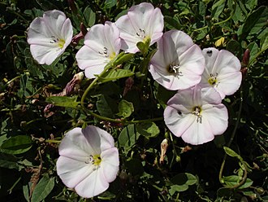
Convolvulus arvensis arvensis – of plowed fields
Common Names: field bindweed, lesser bindweed, European bindweed, withy wind, perennial morning glory, creeping jenny , possession vine
It is said that the dense growth of this invasive plant invades agricultural fields and causes tremendous crop damage

Slide 21
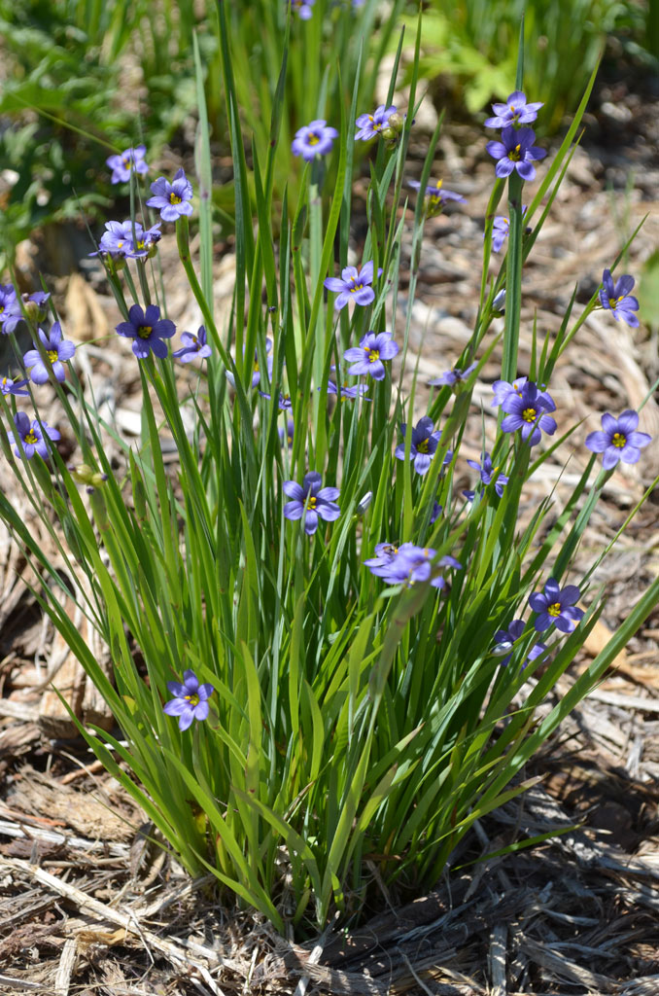
Sisyrinchium campestre campestre – open fields, pastures
Common Name: Prairie-blue-eyed grass
Native to Missouri where it grows in open woods, glades, prairies and grassy areas

Slide 22
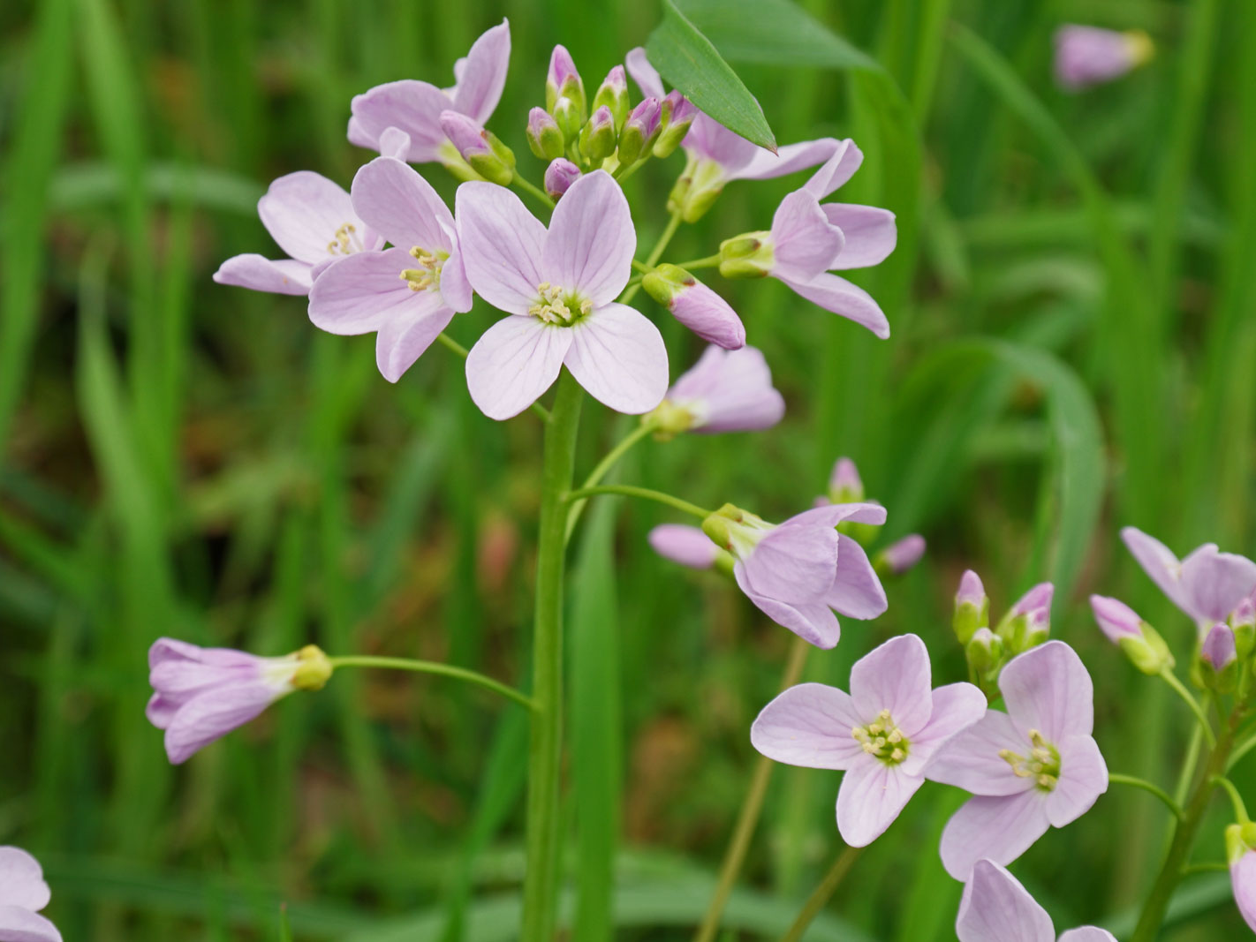
Cardamine pratensis pratensis – of meadows
Common names: cuckooflower, lady’s smock, mayflower or milkmaids
Native in Europe and East Asia, it is called cuckooflower because it blooms at the same time as the arrival of cuckoos in the British Isles each spring.

Slide 23
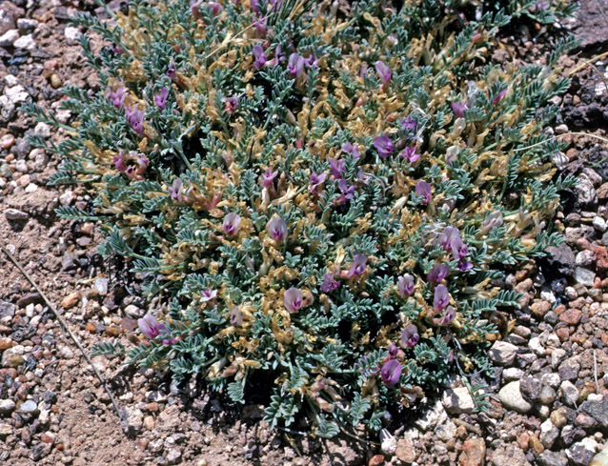
Astragalus siliceus siliceus – growing on sand
Common Name: Flint Mountains Milkvetch
A densely tufted plant that is native to New Mexico. It grows in dry, rocky sandy areas

Slide 24
WETLAND HABITAT
aquaticus – in water
fluitans – floating
palustris – of marshy ground
pluvialis – of rainy places

Slide 25
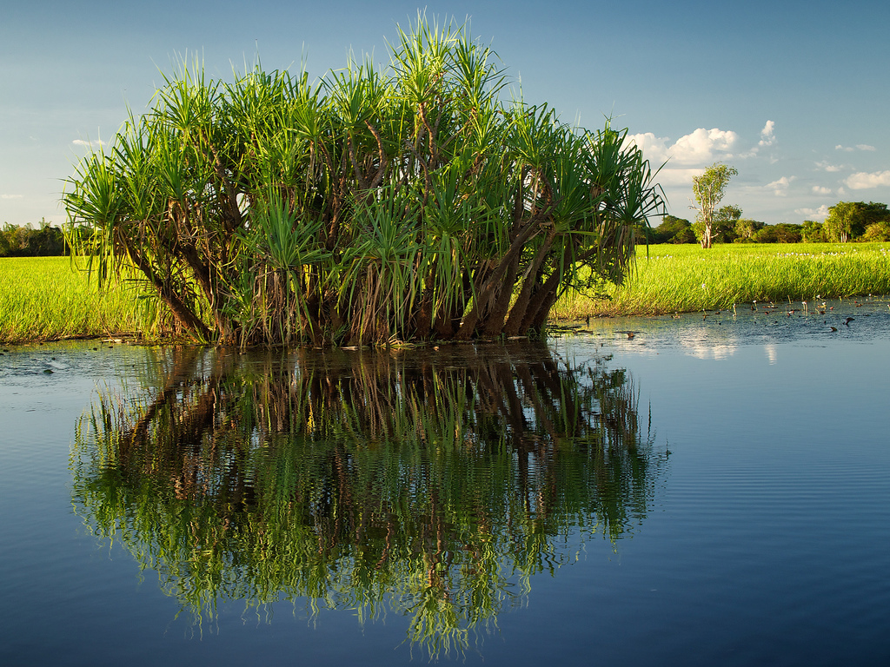
Pandanus aquaticus aquaticus – in water
Common Name: River Pandanus or Water Pandan
A palm-like tree native to the Old World Tropics and sub-tropics that grows in shallow water. This photo is from Kakadu National Park in the Northern Territory of Australia.

Slide 26
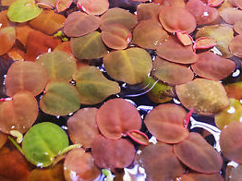
Phyllanthus fluitans fluitans - floating
Common Name: Red Root Floater
This is a colorful floating aquatic perennial growing two inches tall. Native to South America from the Amazon Rive Basin…perfect for a planted aquarium.

Slide 27
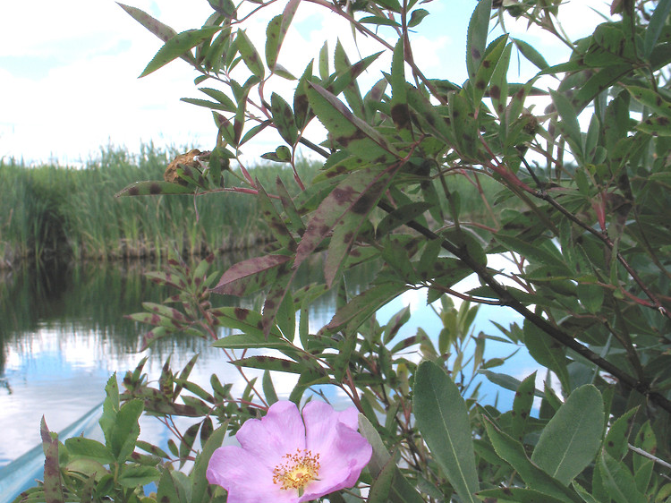
Rosa palustris palustris – of marshy ground
Common name: Swamp Rose
Native to much of the eastern half of North American from Nova Scotia down to Florida. Its pink blossoms last for six to eight weeks in June and July.

Slide 28
NEXT TIME???
Terms to describe plants that resemble other things or other plants
Terms to describe plants that resemble animals (!)
Terms that refer to famous plantsmen
Terms that refer to famous plantswomen

