Slide 1
LATIN FOR GARDENERS V
Names for plants resembling other things
Names recognizing famous people

Slide 2
RESEMBLING OTHER THINGS
Rosmarinifolius – leaves like those of rosemary plants
Salicifolius – leaves like those of willow trees and shrubs
Quercifolius – leaves like those of oak trees
Primuloides – leaves/flowers like those of primroses
Arboreus - having the form or size of a tree

Slide 3
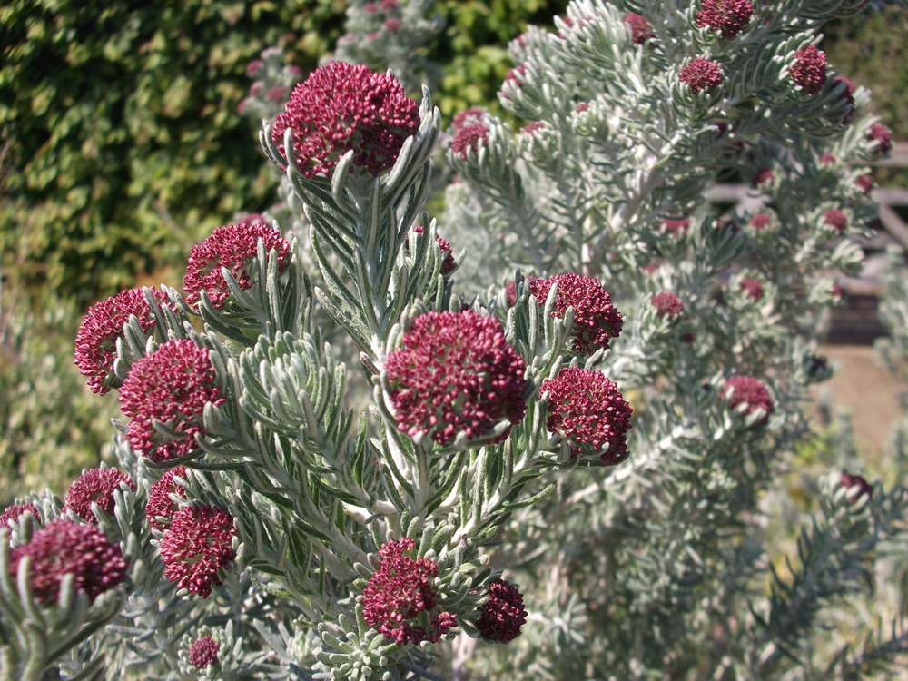
Ozothamnus rosmarinifolius rosmarinifolius – with leaves like rosemary
Common name – Rosemary Everlasting
This evergreen shrub from Australia is hardy in the Pacific Northwest. This is a photo of the ‘Silver Jubilee’ cultivar. Great for a full-sun, drought –tolerant garden. Pink flower buds last a long time before opening to tiny white flowers.

Slide 4
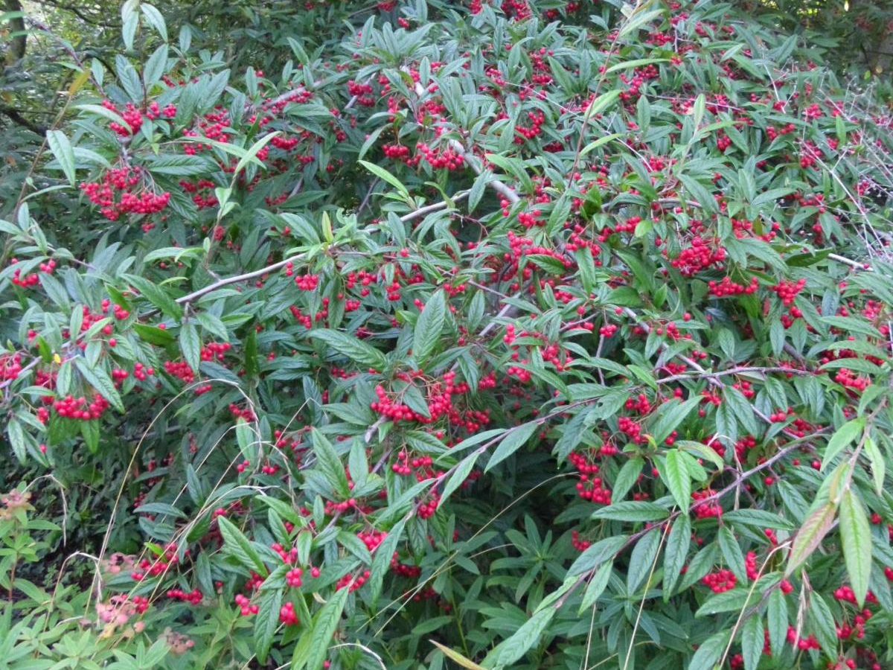
Cotoneaster salicifolius salicifolius – willow-leaved
Common name – Willowleaf Cotoneaster
A drought-tolerant small to medium sized evergreen to semi-evergreen shrub native to China. Branches have a wide arching habit.

Slide 5
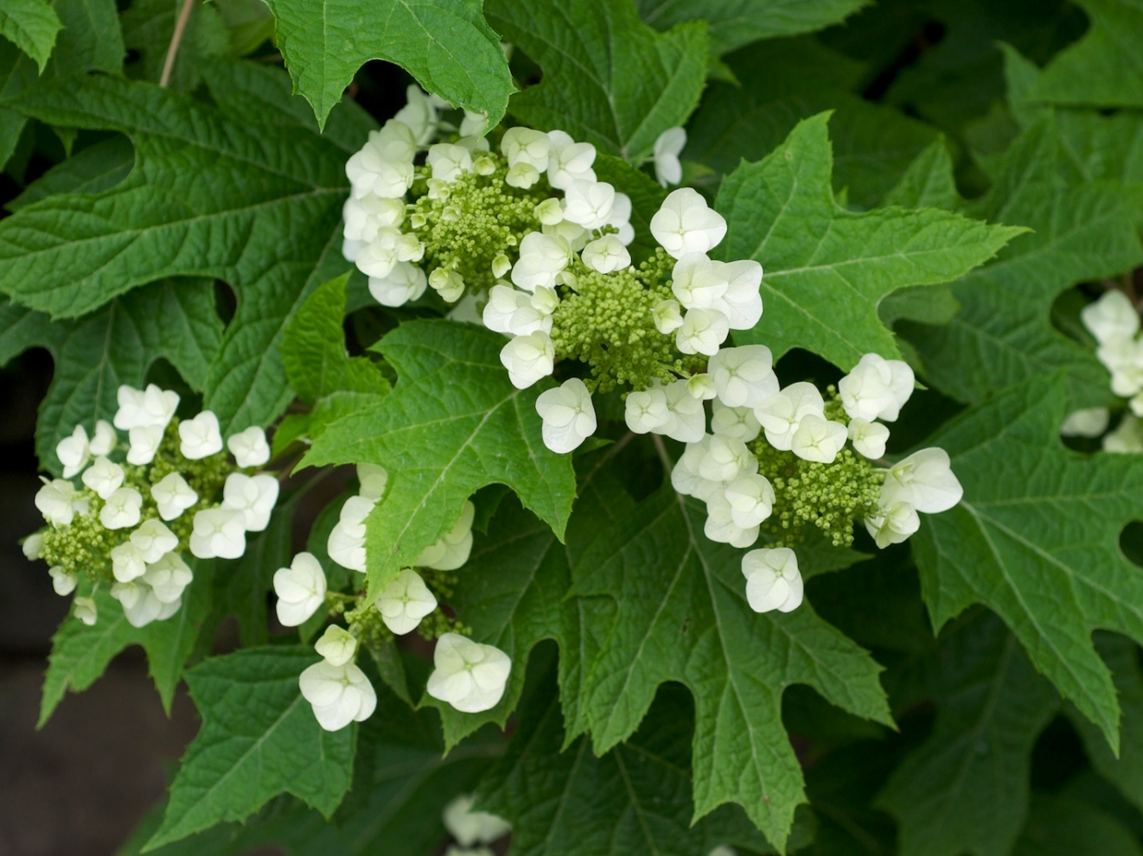
Hydrangea quercifolia quercifolia – with oak-like leaves
Common name – Oakleaf Hydrangea or Oak-leaved Hydrangea
A popular form of hydrangea with very showy blossoms, but whose leaves closely resemble an oak leaf, native to the Southeastern United States.

Slide 6
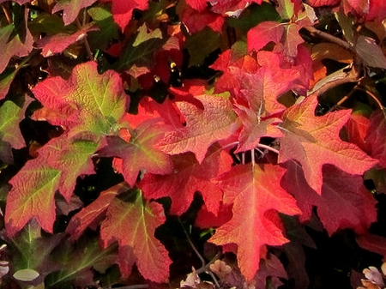
Hydrangea quercifolia
IN FALL!!

Slide 7
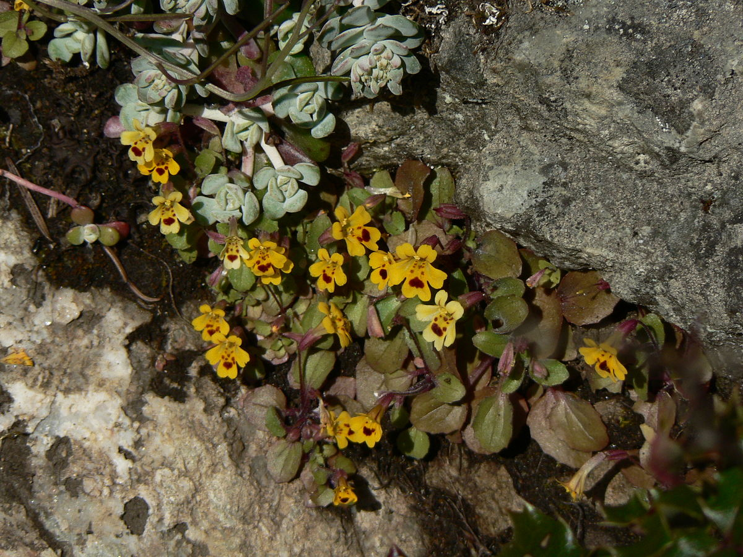
Erythranthe primuloides primuloides – like a primrose
Common Name – Primrose Monkey-flower
Formerly known as Mimulus primuloides
This plant is a perennial herb from the western United States growing in wet habitats. It can be found growing from 2,000 to 11,000 feet in the Eastern Sierra Nevadas.

Slide 8
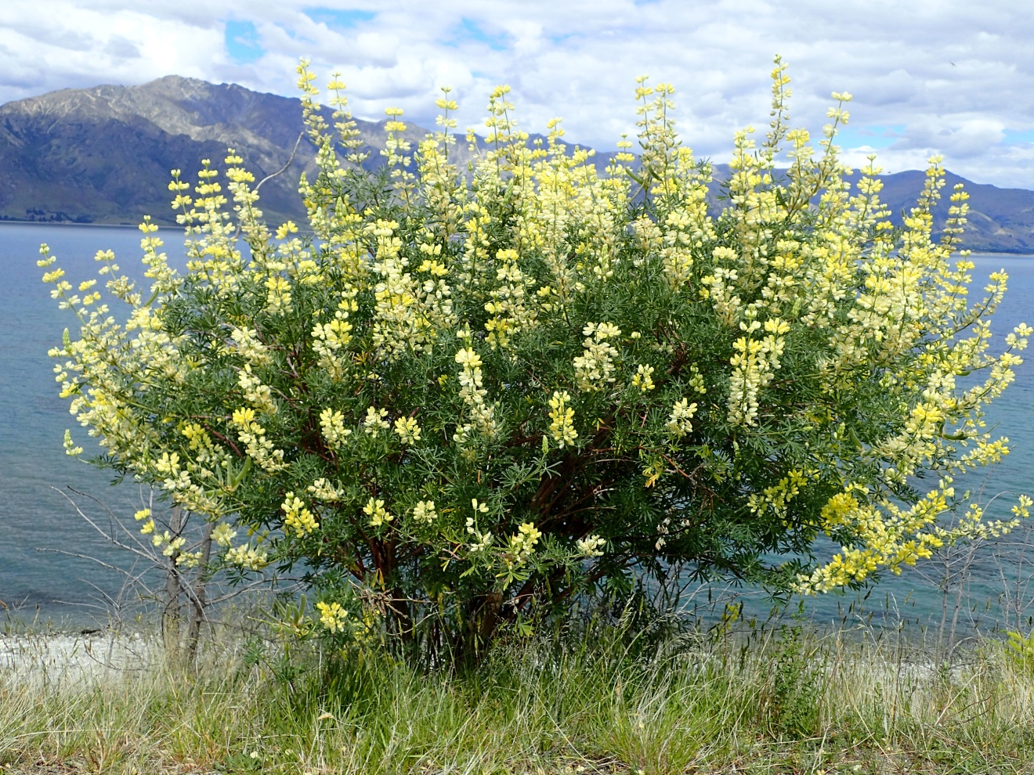
Lupinus arboreus arboreus – tree-like
Common name – Tree Lupine or Yellow-Bush Lupine
Shrub found growing widely along the coast of California – thought to be native to from Point Reyes to San Luis Obispo.
Has won RHS Award of Garden Merit or is it a noxious weed!!??
Notes:
Imported in Europe and now is considered a noxious weed in parts of Germany, Poland and Czechoslavakia

Slide 9
RESEMBLING ANIMALS
Arcturus – like a bear’s tail
Crista-galli – like a cock’s comb
Tigrinus – like a tiger
Pes-caprae – like goat’s foot
Papilio – like a butterfly

Slide 10
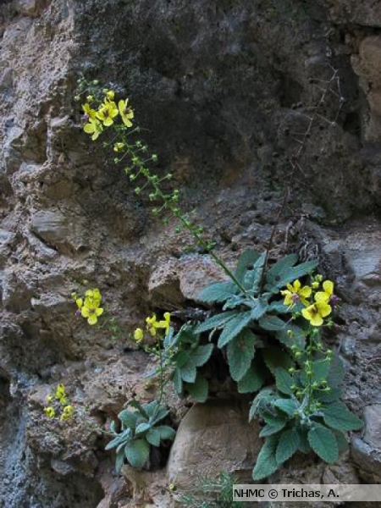
Verbascum arcturus arcturus – like a bear’s tail
Common name – Cretan Bear’s Tail
This plant happily grows in crevices on cliff faces and other inhospitable places, is drought tolerant and deer resistant but also good in the front of borders and in containers. Long lasting blooms from Spring through Summer.

Slide 11
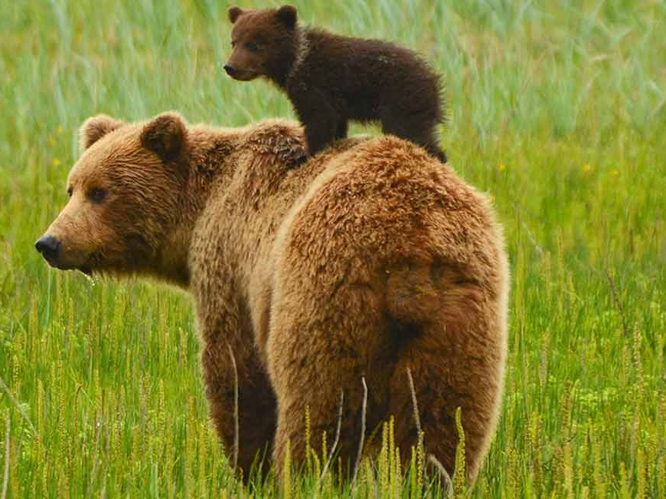

Slide 12
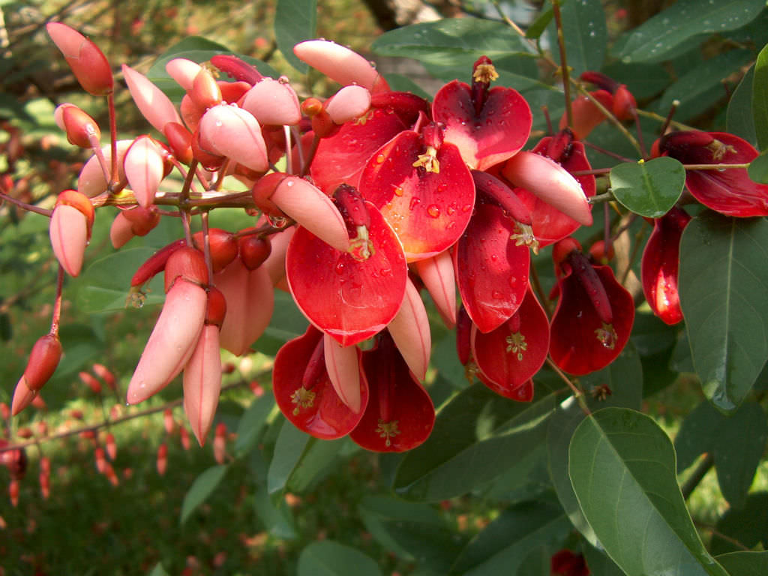
Erythrina crista-galli crista-galli – like a cock’s comb
Common Name – Cockspur Coral Tree
This tree which is native to South America has been widely planted as a street tree in Southern California. It is the national tree of Argentina and national flower of Uruguay.

Slide 13
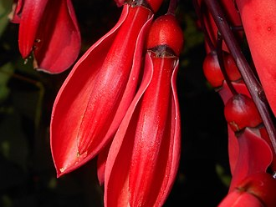
Another close-up of the flower

Slide 14
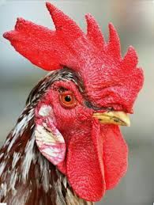

Slide 15
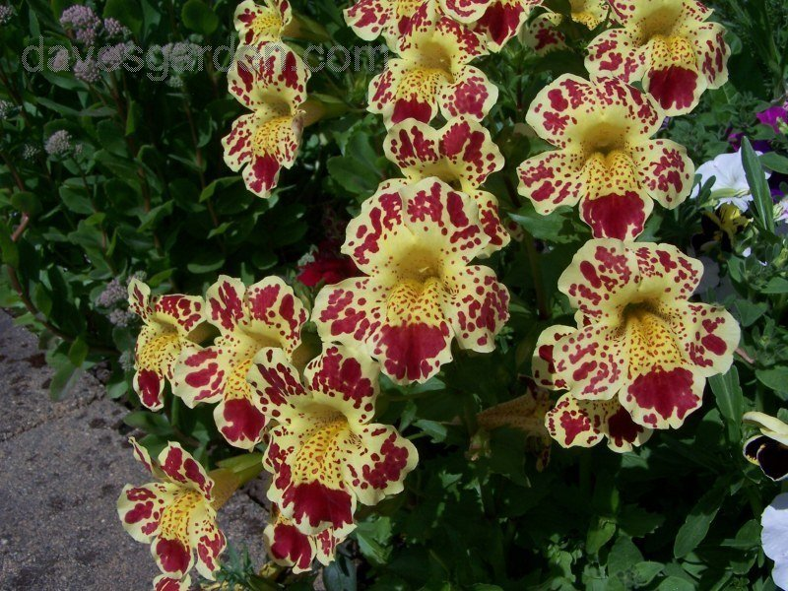
Mimulus tigrinus tigrinus – like a tiger
Common name - Tiger Monkey-flower
A bright-flowering annual wildflower whose genus and species both refer to animals! Mimulus refers to the flower shape being like that of a clown monkey face and tigrinus refers to this particular species being striped like a tiger.

Slide 16
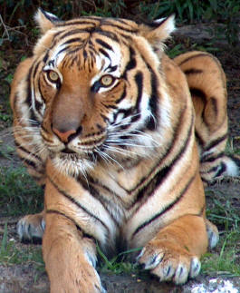
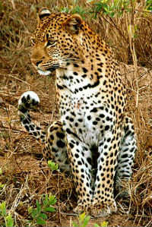
Tiger or leopard?!

Slide 17
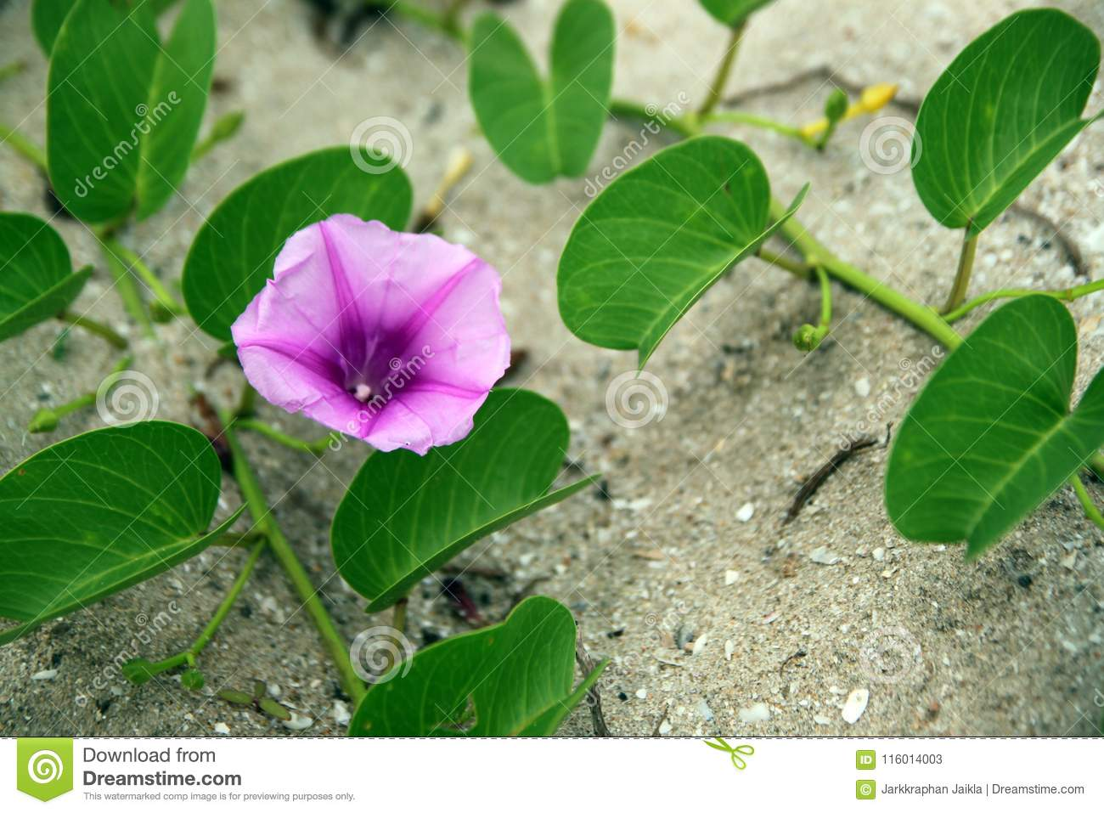
Ipomoea pes-caprae pes-caprae – like a goat’s foot
Common Names – Bayhops, Beach Morning Glory or Goat’s Foot
A prostrate perennial creeping vine native to tropical shores of the Atlantic, Pacific and Indian Oceans. Its seeds float and are not affected by saltwater, thus its wide dispersal along beaches and is a primary sand stabilizer.

Slide 18
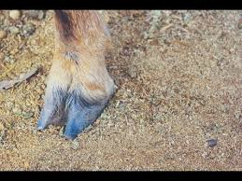

Slide 19
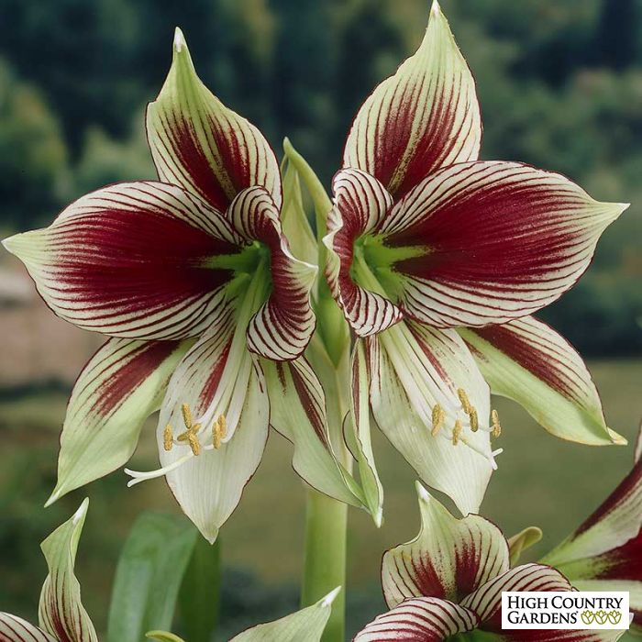
Hippeastrum papilio papilio – like a butterfly
Common name – Butterfly Amaryllis
This flowering perennial was found in the tropical rainforests of southern Brazil in the 1960s. It is endangered but is becoming increasingly popular.

Slide 20
Plants Recognizing Famous Male Horticulturists
Armandii – after Father Armand David
Banksii – after Joseph Banks
Douglasii – after David Douglas
Menziesii – after Archibald Menzies
Edgeworthia – after Michael Pakenham Edgeworth

Slide 21
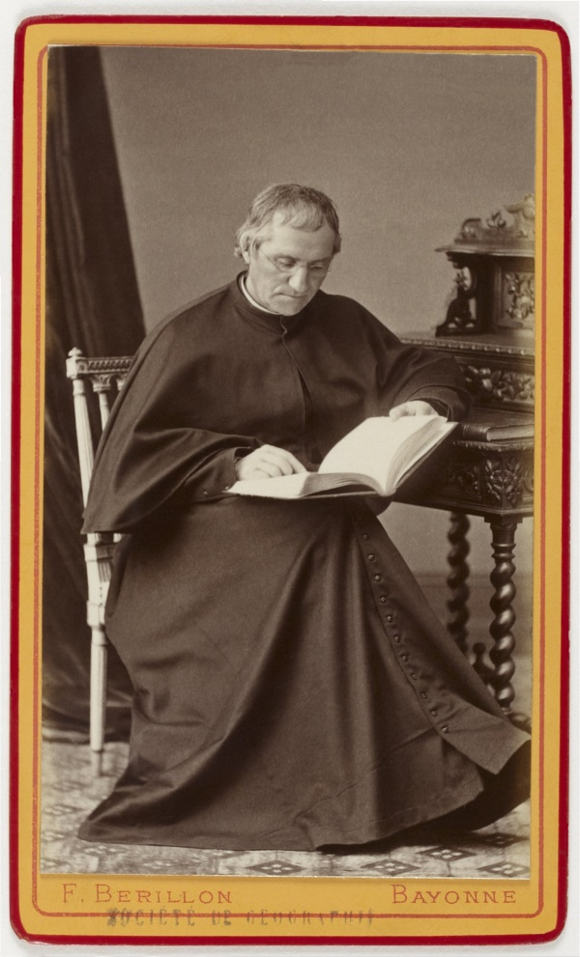
Father David Armand – 1826-1900
A French Lazarist missionary who was also a zoologist and botanist - famous for “discovering” the Panda Bear in China – he sent back to Paris over 52 species of rhododendron and 40 species of primulae among countless other plant species. He had plants named for him after both his forename and surname.

Slide 22
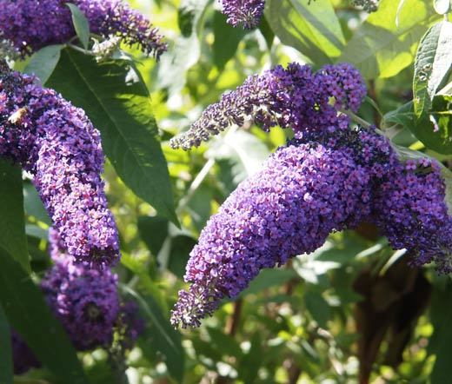
Buddleia davidii davidii – after Pere David Armand
Common names – Summer Lilac, Orange Eye or Butterfly-Bush
Ornamental shrub named after Pere David Armand which is cultivated worldwide. Armand was the first European to report the shrub, another botanist actually found it and yet another exported the first seed. The plant was first for sale in the 1890’s.

Slide 23
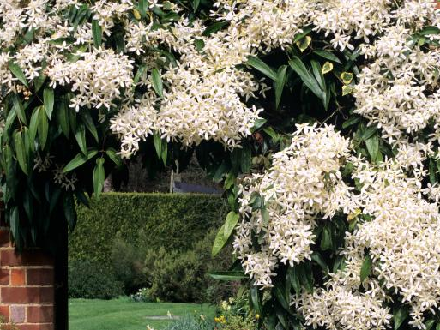
Clematis armandii armandii – after Pere David Armand
Common Name – Armand Clematis or Evergreen Clematis
A popular evergreen clematis with a sweetly fragrant blossom in late winter to early spring native to China and northern Burma.
Notes:
An e

Slide 24
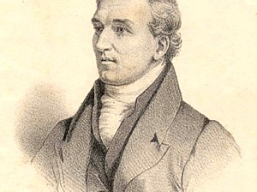
David Douglas 1799-1834
Scottish botanist who studied under William Jackson Hooker at Glasgow University. He made three trips to N. America, first to eastern N. America, then secondly to the Pacific Northwest and the third from the Columbia River to San Francisco and to Hawaii. Second trip considered his most successful. He introduced the Douglas Fir into cultivation in 1827.
Died in Hawaii at the age of 35.
Notes:
His death is a total mystery even to this day but it happened on Mauna Kea in Hawaii. Fell into a bullock pit and was supposedly crushed by a wild bullock. His wounds looked more like they came from an ax and he was missing the bag of gold coins he had been carrying. People believe he was murdered by an ex-convict from Australia to whom he had unwisely shown the bag of gold he was carrying that day. We may never know but there is some kind of memorial to David Douglas over there near Mauna Kea and I am going to find it.

Slide 25
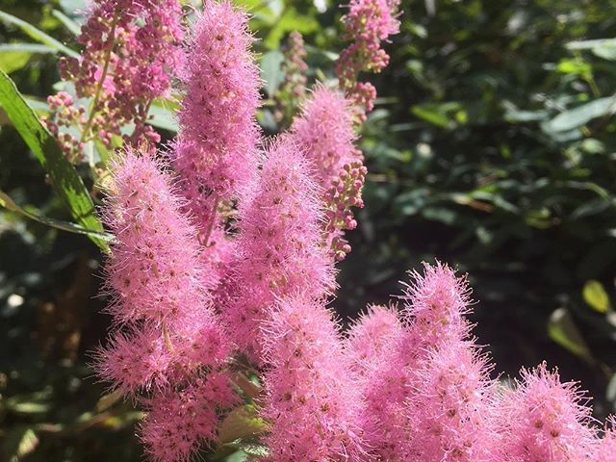
Spirea douglasii douglasii – after David Douglas
Common names: Hardhack, Hardhack Steeplebush, Douglas Spirea,
Steeplebush and Rose Spirea
Native from Alaska to Pacific Northwest – imported to Europe and considered invasive in some areas. Prefers wetlands but will grow anywhere.
Notes:
Imported to Europe and has become invasive in parts of Germany, Poland and Czechoslavakia.

Slide 26
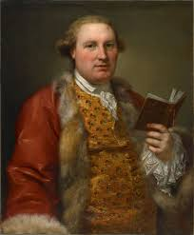
Archibald Menzies
1754 - 1842
A Scottish surgeon, naturalist and botanist who served with the Royal Navy.

Slide 27
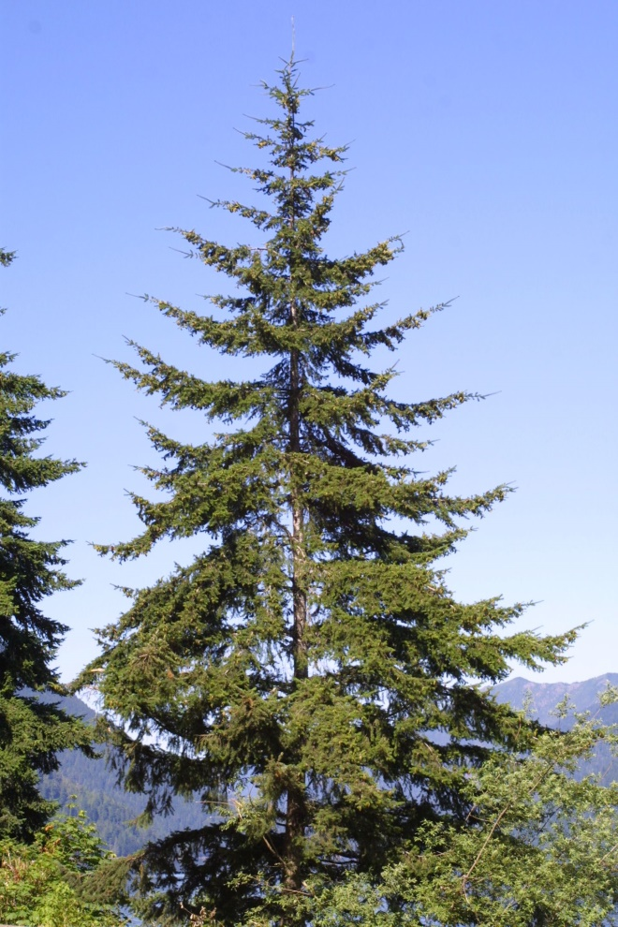
Pseudotsuga menziesii menziesii – after Archibald Menzies
Common names – Douglas Fir, Douglas-fir, Oregon Pine, Douglas Spruce, Red Fir, Red Pine , Puget Sound Pine, False Hemlock and Columbian Pine
The common name Douglas Fir is misleading because it is not actually in the fir genus of Abies. It is in the pseudotsuga genus.
First documented by Menzies in 1794 on Vancouver Island.

Slide 28

Michael Pakenham Edgeworth 1812-1881
An Irish-born botanist born into a family of 24 children. He specialized in collecting seeds and ferns. Studied at the University of Edinburgh and spent most of his career in India.

Slide 29
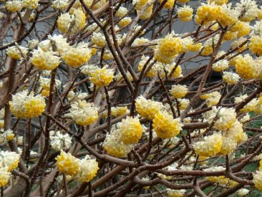
Edgeworthia chrysantha edgeworthia – after Michael Pakenham Edgeworth
Common names – Chinese Paperbush, Edgeworthia
Native to the Himalayas and China – prized for its bark from which quality paper was made

Slide 30
PLANTS RECOGNIZING FAMOUS FEMALES
Danfordiae – after Mrs. C. G. Danford
Florindae – after Florinda N. Thompson
Regina-Olgae – after Queen Olga of Greece
Robbiae – after Mary Ann Robb
Wilmottianum – after Ellen Ann Willmott

Slide 31
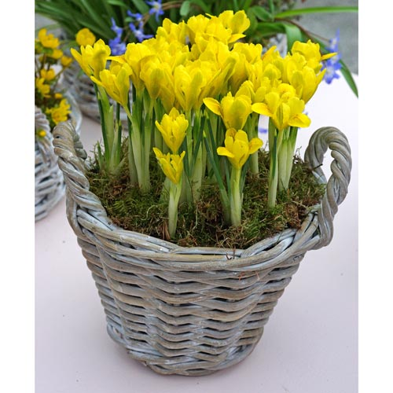
Iris reticulata danfordiae danfordiae – after Mrs. C. G. Danford
Common names – Dwarf Iris, Buttercup Iris or Danford’s Iris
This species was introduced from Cilicia, Turkey and was named after Mrs. Danford, who was an English plant hunter of the Asia Minor regions. She discovered it in 1876. It is one of the first in the reticulata group to bloom, often in early February.

Slide 32
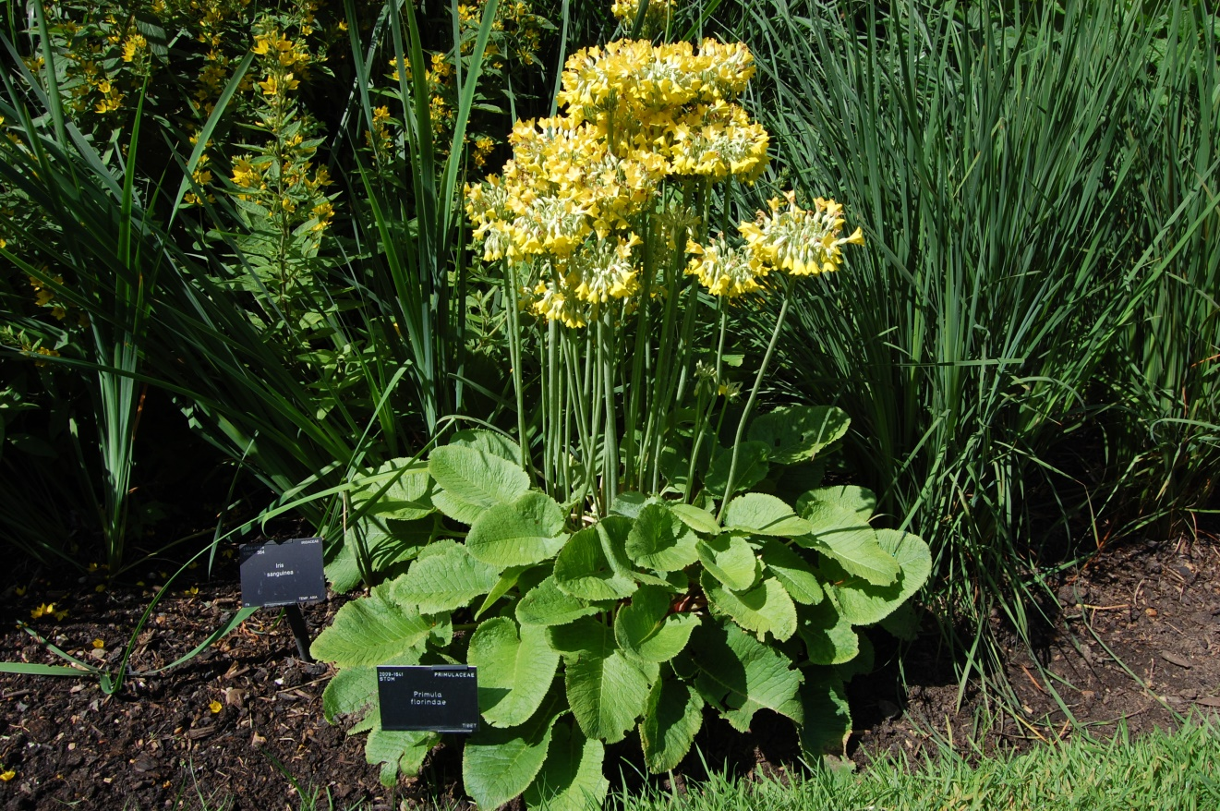
Primula florindae florindae – after Florinda N. Thompson
Common names – Giant Cowslip, Tibetan Cowslip, Bog Primula, Himalayan Cowslip, Tibetan Primrose, Florinda Primrose
Native to southeastern Tibet, this very fragrant long-lived perennial grows up to 4 feet tall and increases yearly; takes full sun to shade, moist soil and deer and rabbits don’t like it!
Florinda was the first wife of Francis Kingdon-Ward , a British Botanist who traveled extensively in Tibet, NW China, Myanmar and Assam. After their divorce, Florinda stood as a Liberal Party candidate to Parliament in 1950.

Slide 33
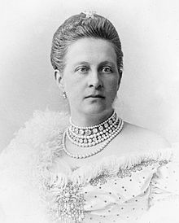
Queen Olga of Greece
- Wife of King George I of Greece and a member of the Romanov family. She was the grandmother of Prince Philip, Duke of Edinburgh.

Slide 34
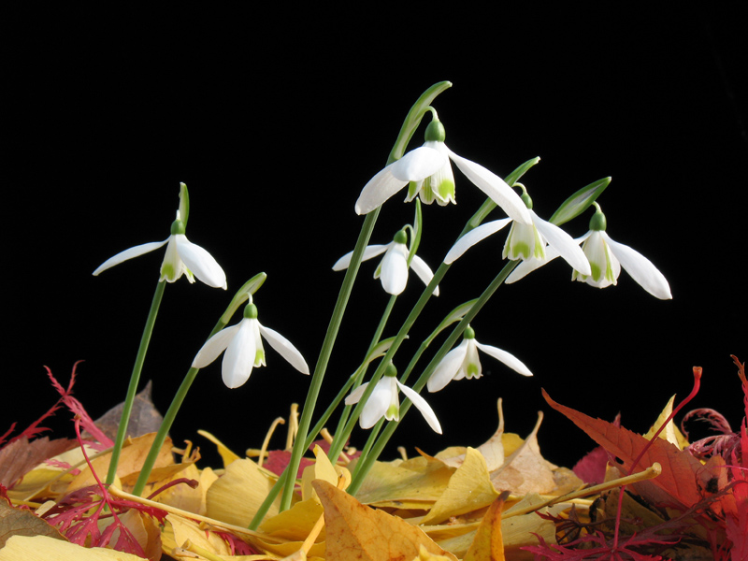
Galanthus regina-olgae regina-olgae – after Queen Olga of Greece
Common Name: Autumn Snowdrop, Queen Olga’s Snowdrop
This plant was first described in 1876 by botanist Theodorus G. Ophanoides, a leading Greek botanist (1817-1876) and named in honor of then Queen of Greece Olga.
Native to Sicily and the Balkans, this bulb is the best known of the autumn flowering snowdrops and will tolerate dry shade.

Slide 35
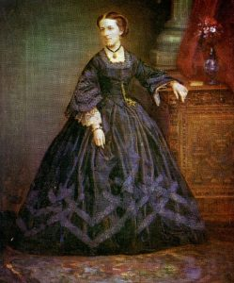
Mary Ann Boulton Robb 1827-1912
An early photographer and the third woman to join the Photographic Society in 1853, its founding year. She was widowed with two young children at age 30 and travelled widely on the continent to practice her photography and to search for plants for her 150 acre estate in England called Chiltley Place.

Slide 36
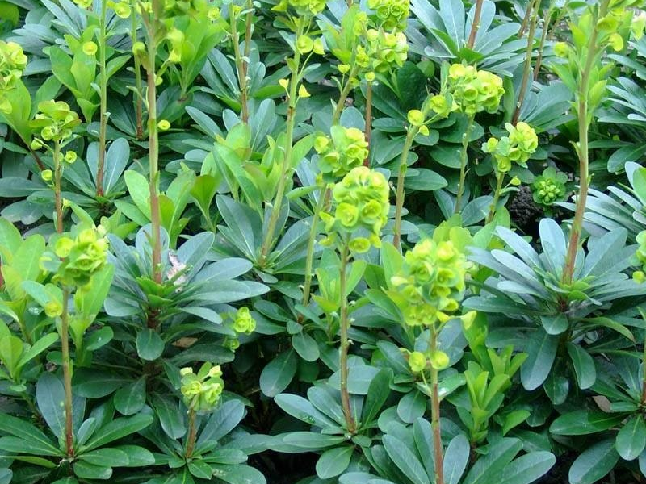
Euphorbia robbiae robbiae – after Mary Ann Robb
Common names – Wood Spurge , Robb’s Spurge or Mrs. Robb’s Hatbox
This herbaceous perennial thrives in well-drained sunny locations

Slide 37
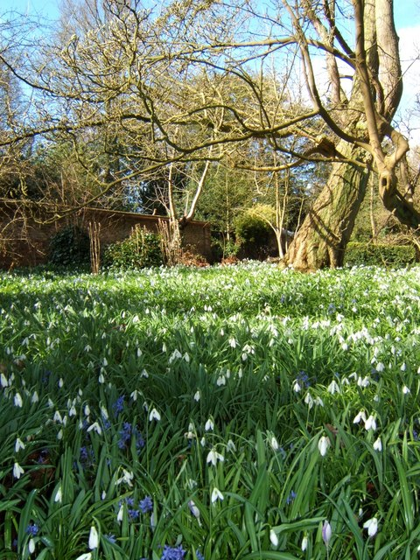
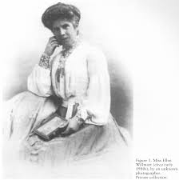
Miss Ellen Ann Willmott 1858-1934
English Horticulturalist who is said to have cultivated 100,000 species and cultivars of plants. Over 60 plants have been named after her or her 33 acre estate called Warley Place in Essex.
Warley Place Nature Reserve

Slide 38
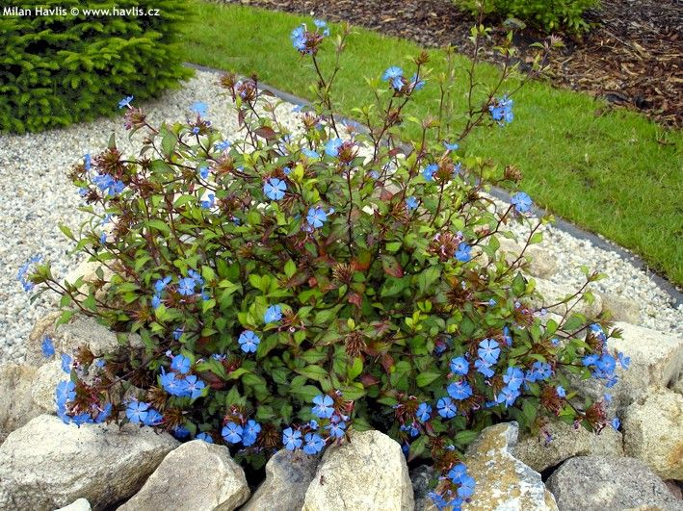
Ceratostigma willmottianum willmottianum – after Ellen Ann Willmott
Common name – Chinese Plumbago
An ornamental deciduous shrub known for its late season red leaves and blue flowers.

Slide 39
NEXT TIME??
COMPASS POINTS AND CONTINENTS
COUNTRIES, STATES AND REGIONS
TOWNS, VILLAGES AND GARDENS

